Slide 2
Spurred by high-profile busts and continued geopolitical unrest, threat actors in 2022 showed a renewed interest in subtlety.
But there was no hiding from SonicWall Capture Labs threat researchers, who were tracking the continued evolution of cybercrime in real time. The 2023 SonicWall Cyber Threat Report offers actionable threat intelligence to arm organizations against today’s ever-changing threat environment.

Slide 3
“The past year reinforced the need for cybersecurity in every industry and every facet of business, as threat actors targeted anything and everything, from education to retail to finance. While organizations face an increasing number of real-world obstacles with macroeconomic pressures and continued geopolitical strife, threat actors are shifting attack strategies at an alarming rate.” BOB VANKIRK PRESIDENT & CEO | SONICWALL

Slide 4
The 2023 SonicWall Cyber Threat Report details an increasingly diversified cyberattack landscape amid shifting threat actor strategies.
SonicWall recorded the second-highest year on record for global ransomware attempts (despite a year-over-year decline), as well as an 87% increase in IoT malware and a record number of cryptojacking attacks (139.3 million) in 2022.
2022 global CYBERATTACK trends

Slide 5
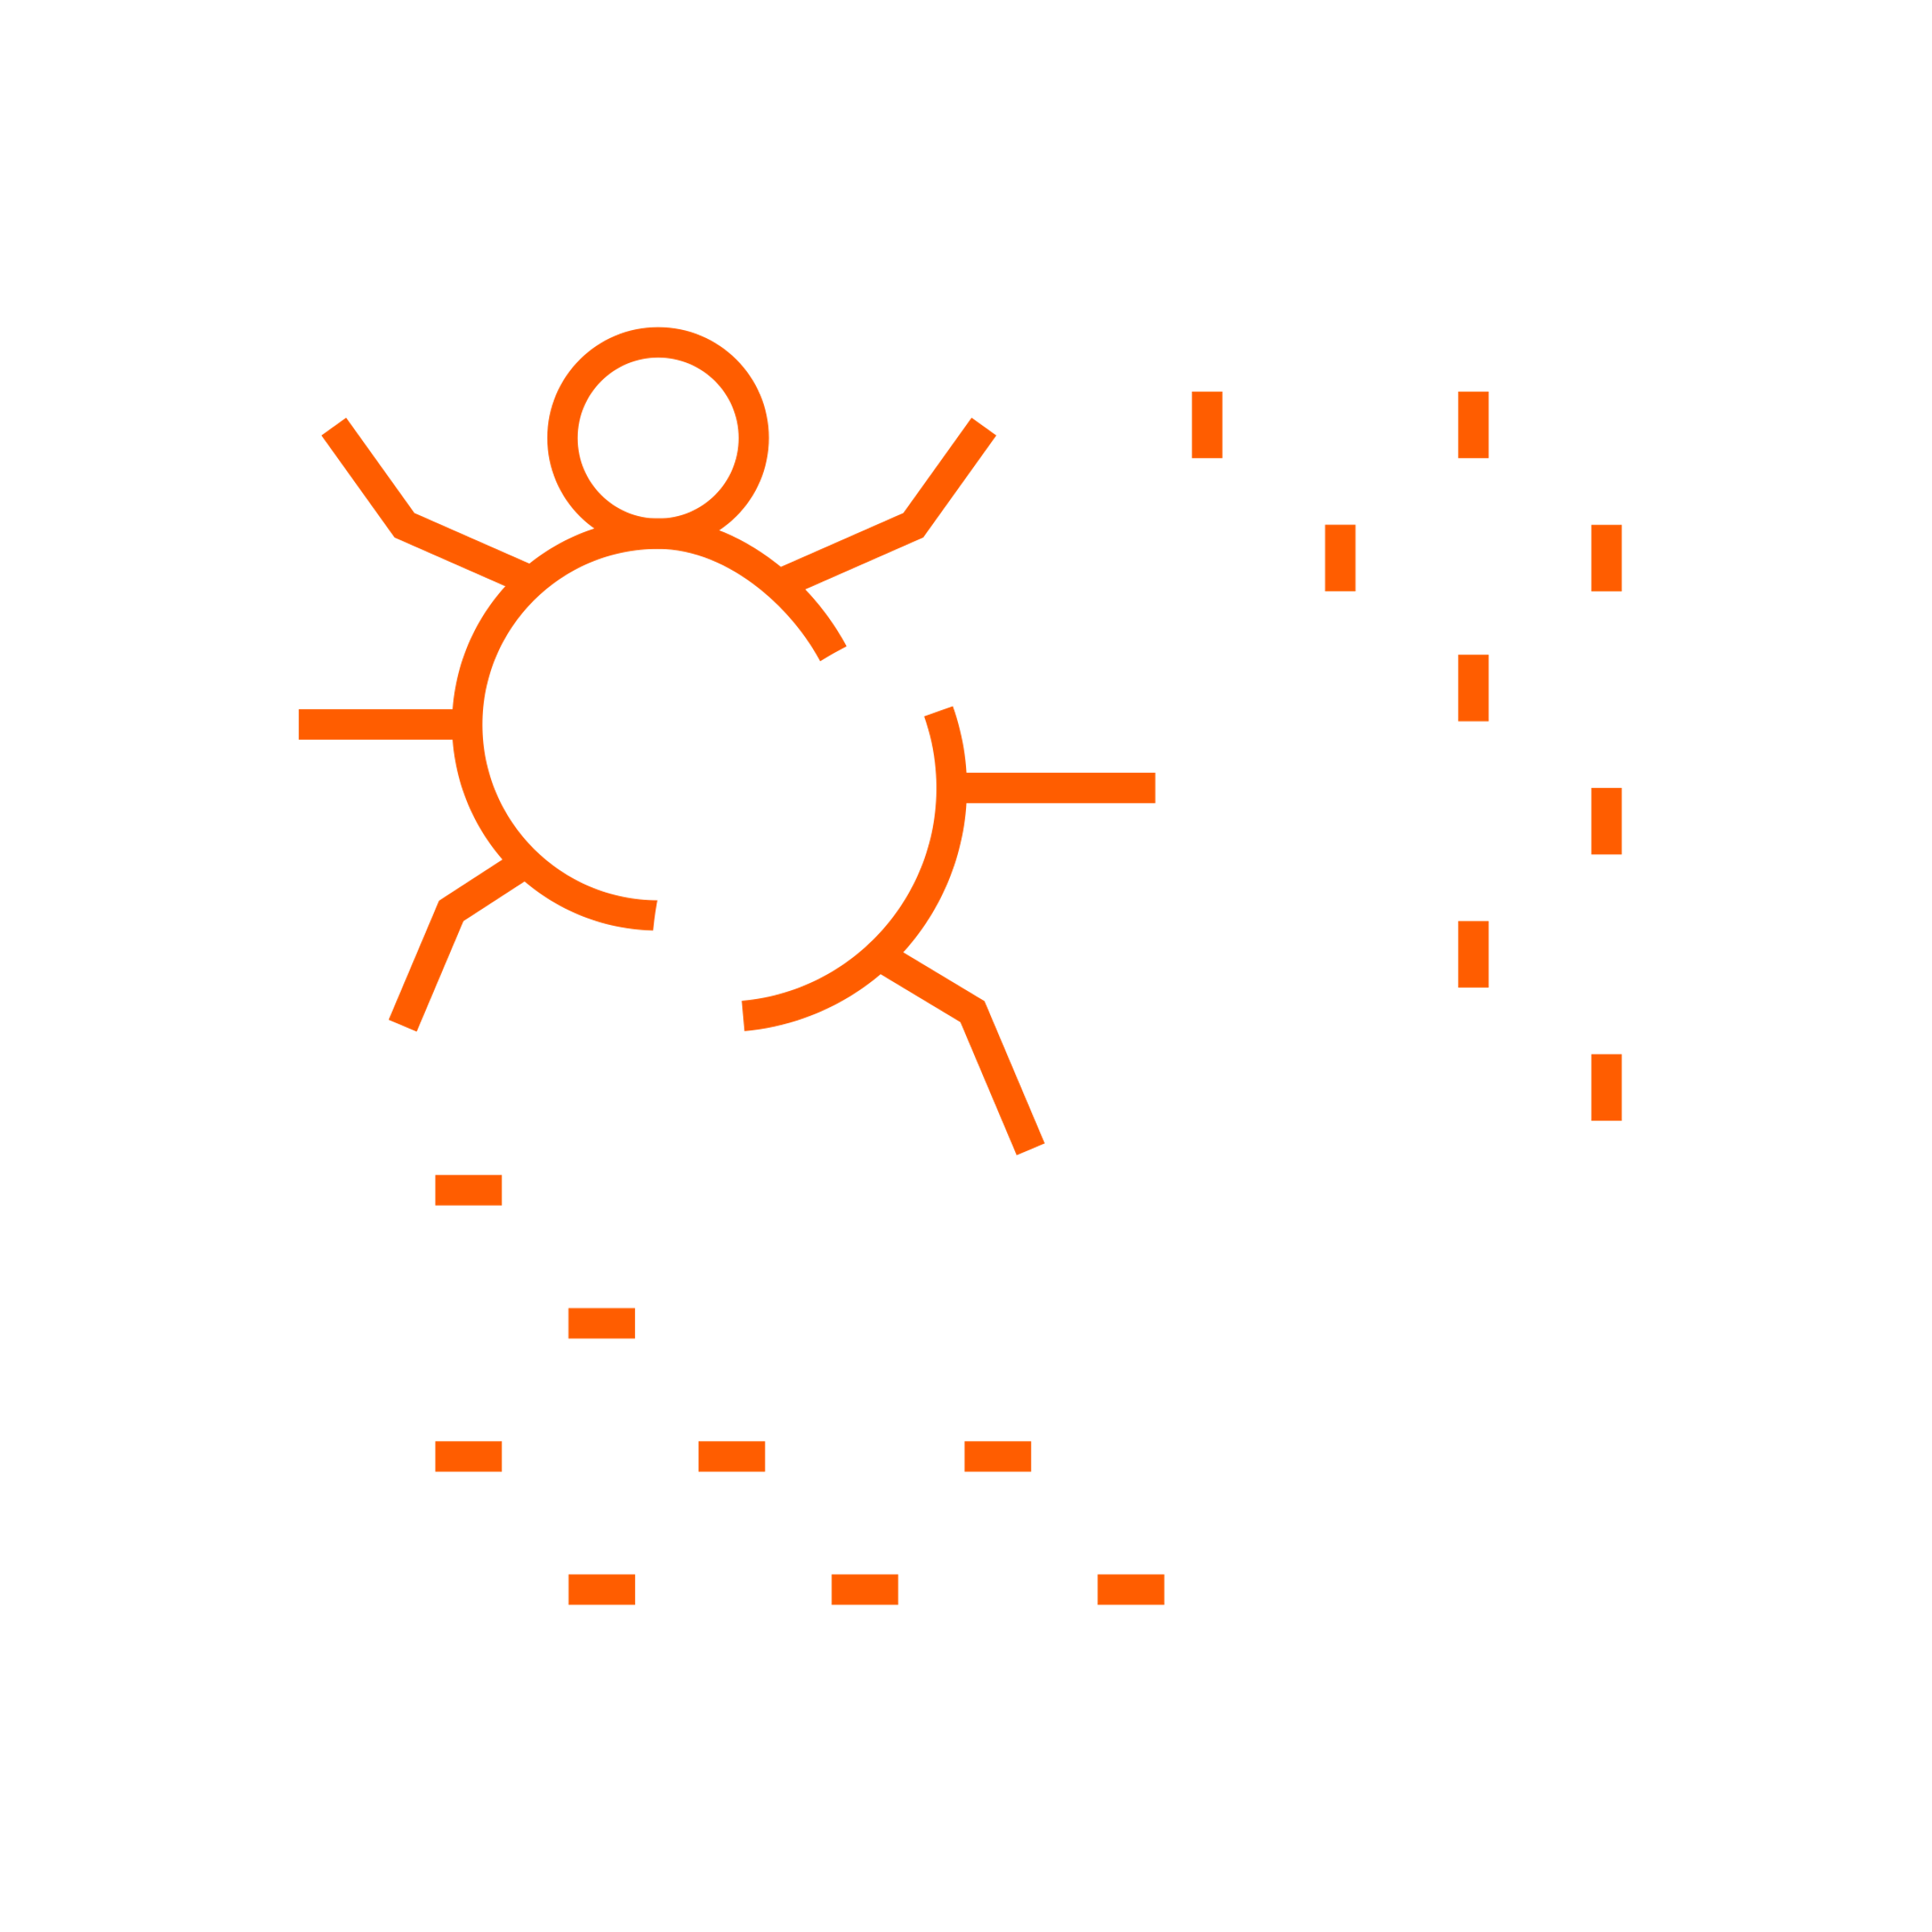
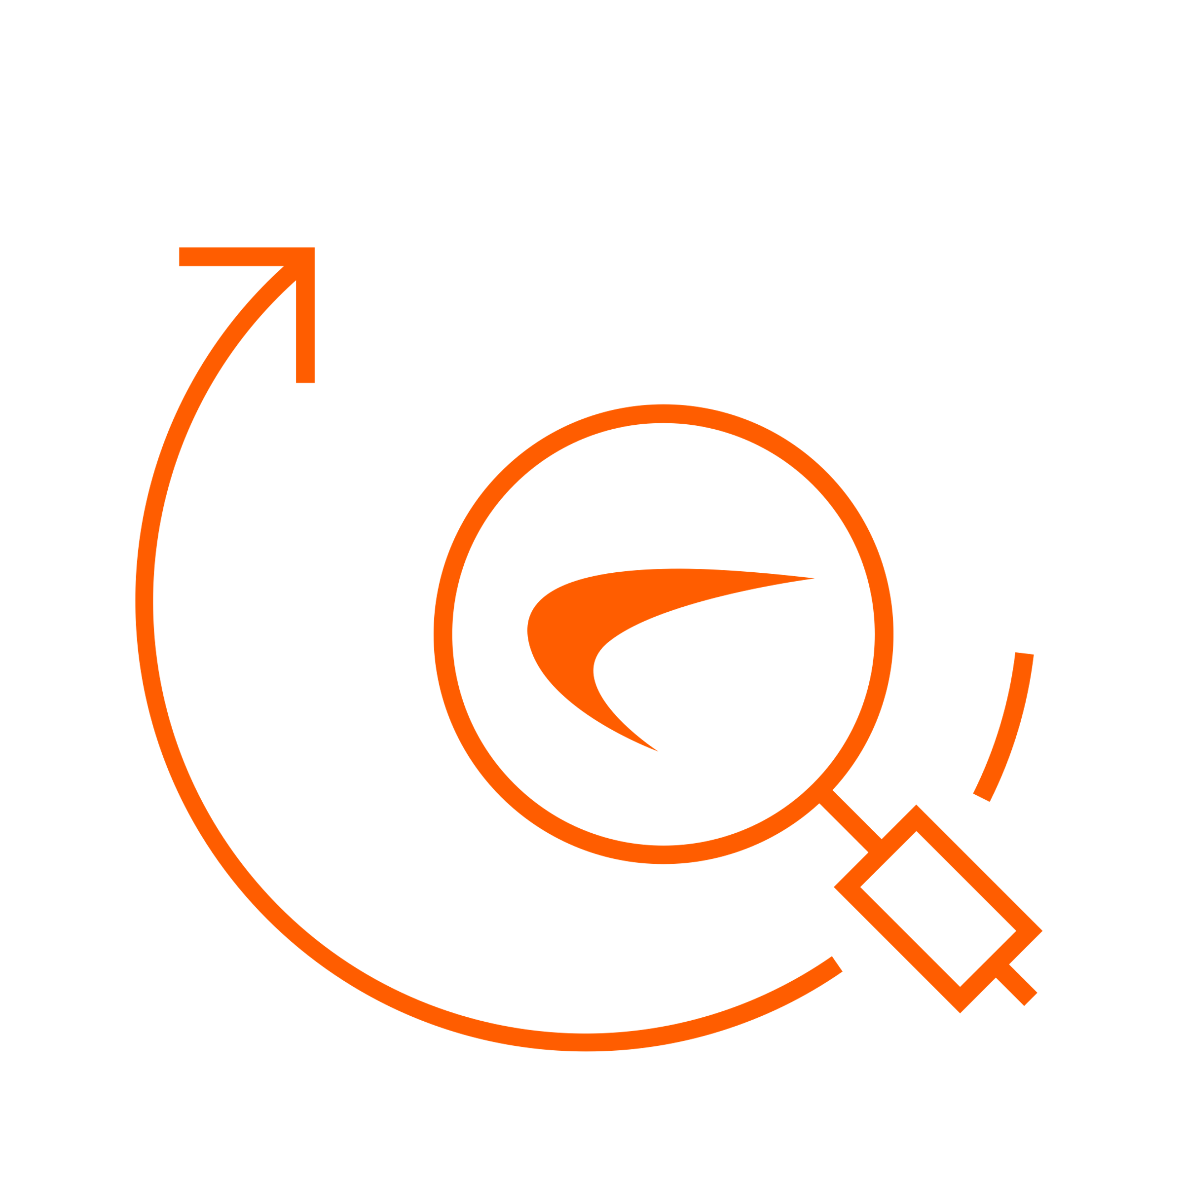
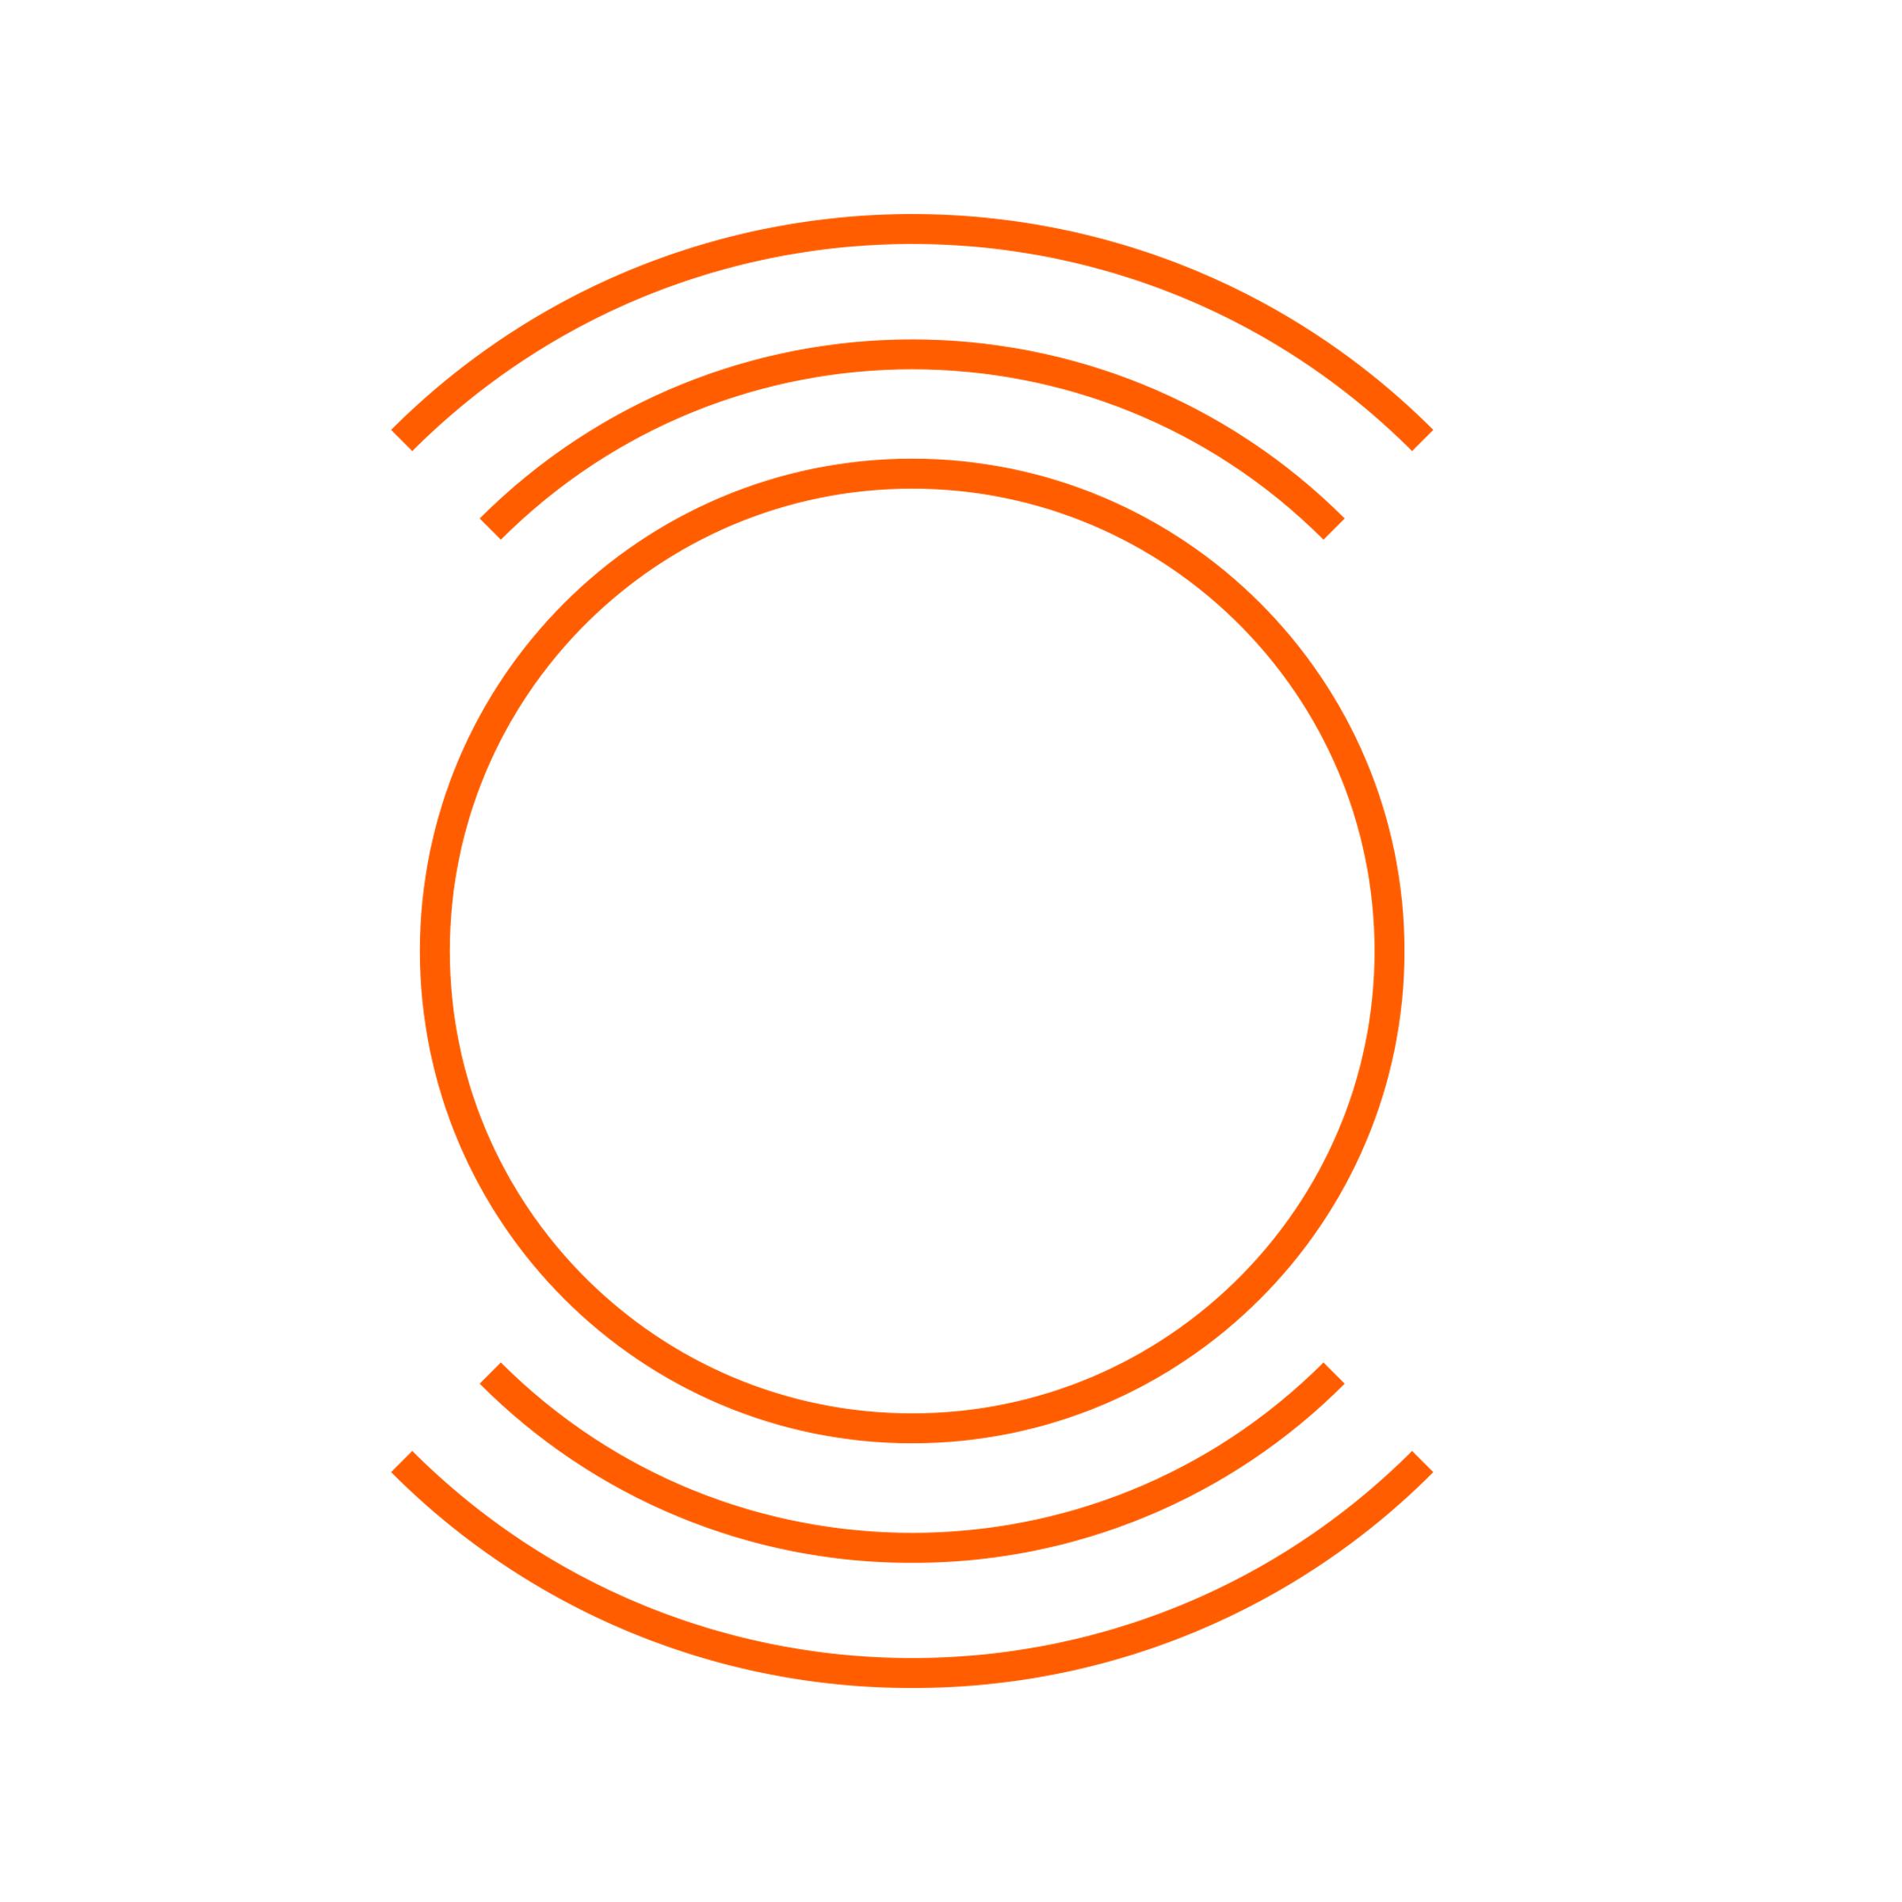
2022 KEY FINDINGS
MALWARE UP FOR FIRST TIME SINCE 2018
OVERALL INTRUSION ATTEMPTS UP
RANSOMWARE CHANGES COURSE
CRYPTOJACKING ON RECORD-BREAKING RUN
RTDMITM DISCOVERIES CONTINUE TO GROW
IOT MALWARE NEARLY DOUBLES
‘LOG4SHELL’ EXPLOITS ECLIPSE 1 BILLION
PHISHERS SWITCH TOPICS IN UNSTABLE CLIMATE

Slide 6
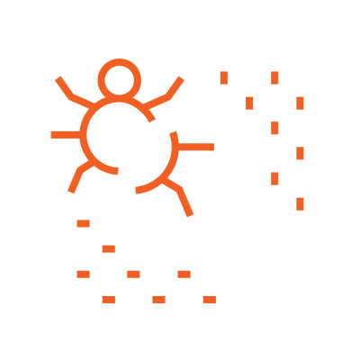
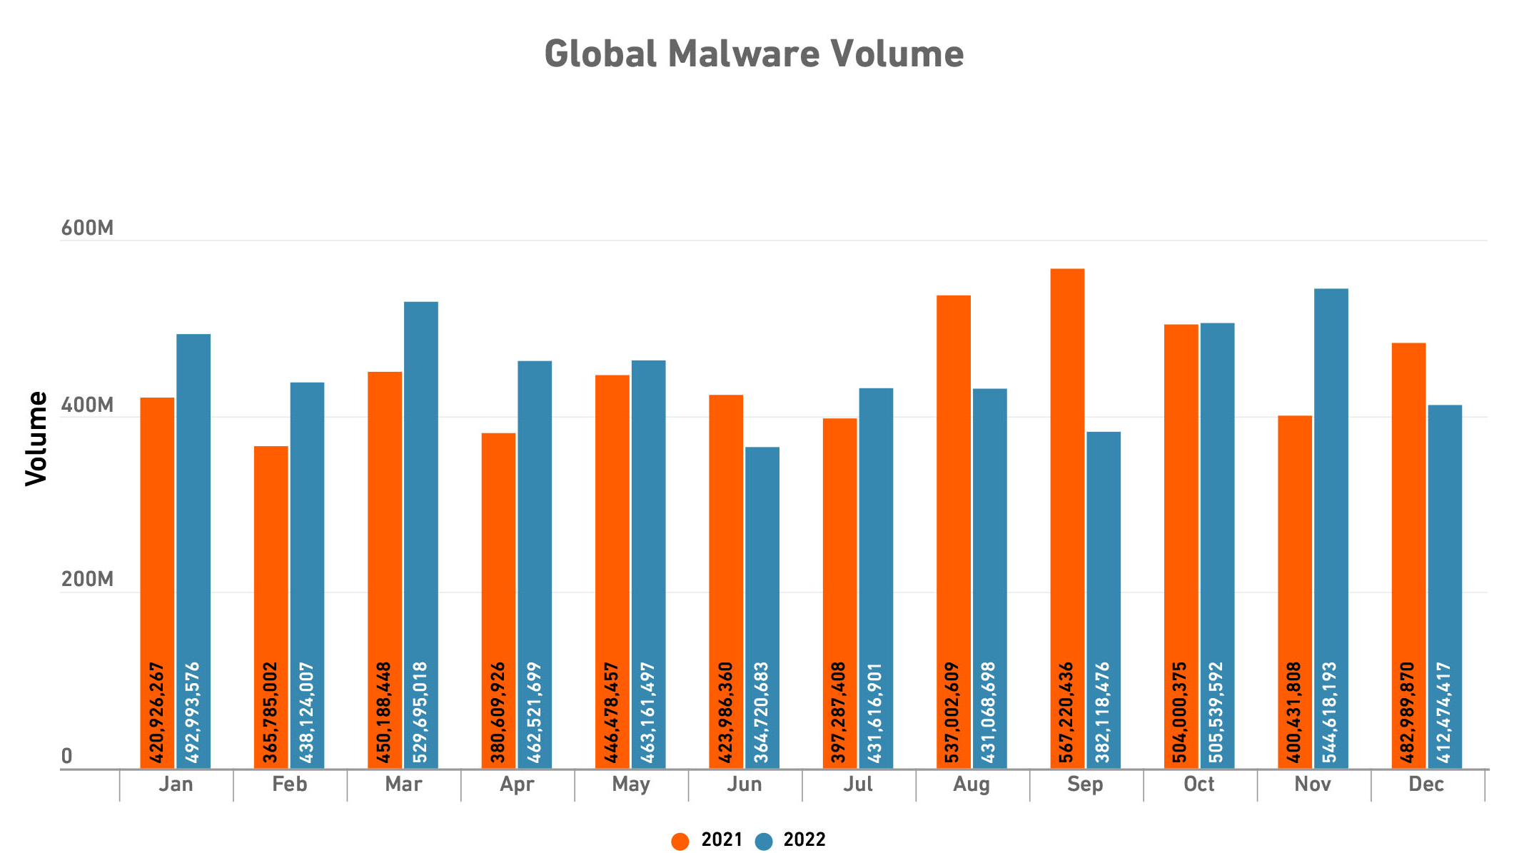
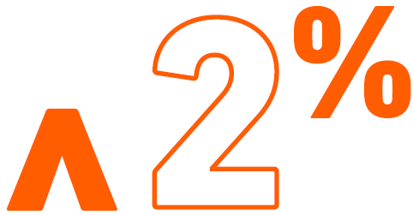
MALWARE UP FOR FIRST TIME SINCE 2018
After three straight years of decline, global malware volume reversed course in 2022, rising 2% to 5.5 billion.
Notes:
While modest, this +2 YoY increase represents the reversal of a longstanding trend: 2022 is the first year since 2018 to see a rise. This was largely fueled by a 43% rise in cryptojacking and an 87% spike in IoT malware, which together offset a 21% drop in global ransomware volume.
As attackers shift tactics, we’re also seeing a shift in targets: malware volume dropped in countries that traditionally see more malware, such as the U.S. (-9%), the U.K. (-13%) and Germany (-28%). The biggest jumps in malware volume were in the Asia-Pacific region (38%) and Latin America (17%), the two regions that typically see the least malware

Slide 7
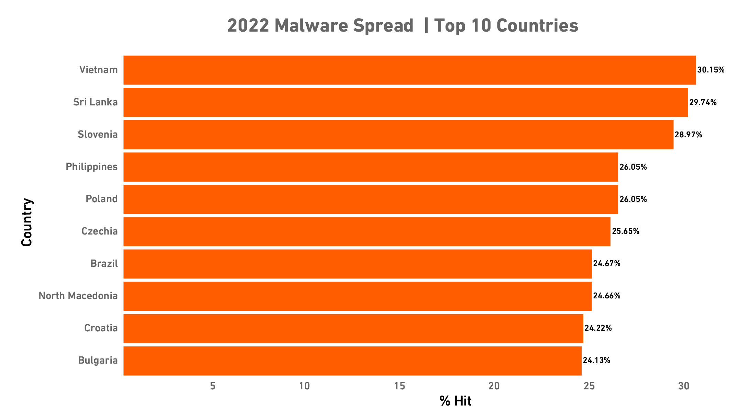
MALWARE: TOP COUNTRIES
Between 2021 and 2022, the number of European countries on the list of most malware doubled, and European countries now make up a majority of the top 10.
Notes:
As in most years, 2022’s country-level data showed a huge variety in outcomes, each of which contributes to the overall shifts we’re seeing at the regional and global level.
At a high level, Vietnam, Sri Lanka and Slovenia had the highest levels of malware spread

Slide 8
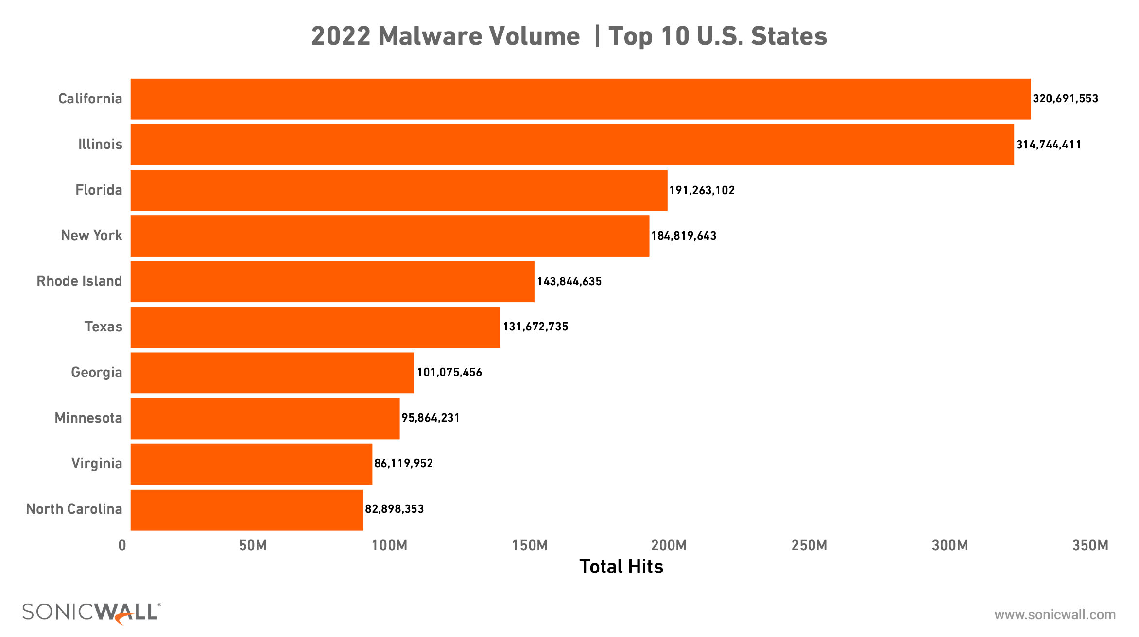
MALWARE: TOP U.S. STATES
In 2022, California had the worst malware attack volume, but with 320.7 million hits, it’s less than half what Florida saw in 2021 — and Illinois was right behind it.
The attack volume for No. 10, however, grew: North Carolina had 82.9 million malware attacks in 2022.
Notes:
This trend echoes what we’re seeing at the regional and country level. States that typically experience more malware are seeing less, and states that may have once considered themselves “safe” are seeing an uptick.
These states weren’t actually the riskiest for malware. In fact, four of the top 10 states for malware volume appeared in the bottom 10 for malware spread, including California. (Only one state on the top-10 list for worst malware volume appears in the top-10 list for worst malware spread: Rhode Island.)

Slide 9
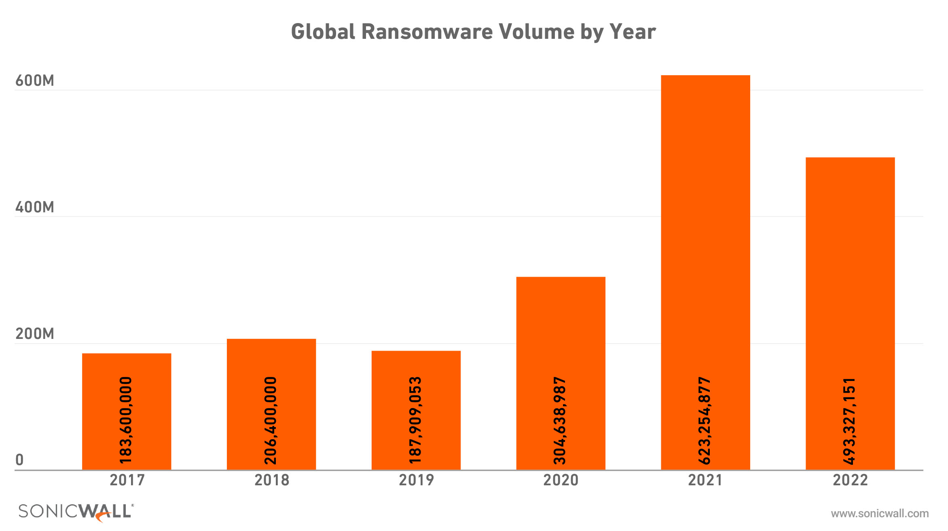
RANSOMWARE CHANGES COURSE
In 2022, SonicWall threat researchers recorded 493.3 million ransomware attacks globally, a 21% year-over-year decrease.
Notes:
Ransomware volumes dipped to 493.3 million in 2022 — a 21% year-over-year decrease. Despite 2022’s global decrease, not every region saw a drop: ransomware in Europe jumped 83%, including a 112% increase in the U.K. The education and finance industries were also heavily targeted, with increases of 275% and 41%, respectively.
But less ransomware does not equal low ransomware: 2022’s total volume still easily eclipses 2018, 2019 and 2020 totals, and amounts to more ransomware attempts than 2019 and 2020 combined.

Slide 10
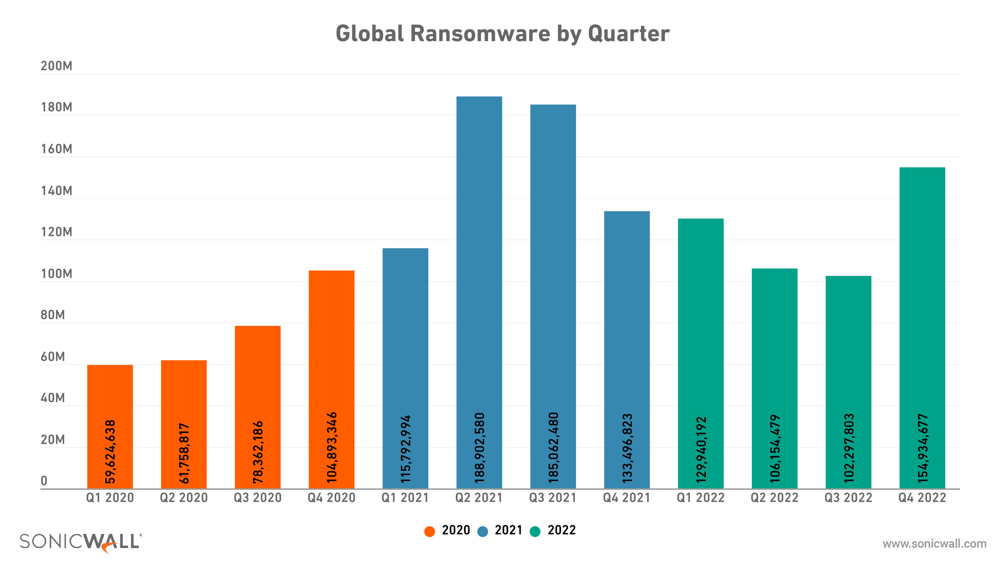
RANSOMWARE CHANGES COURSE
Ransomware began to rise again by the end of 2022, with Q4’s attack volume reaching 154.9 million — the highest since Q3 2021.
Notes:
Worryingly, ransomware began to rise again by the end of 2022, with Q4’s attack volume reaching 154.9 million — the highest since Q3 2021. While attacks are down 21%, 2022’s ransomware volume is still much closer to the sky-high totals we saw in 2021 than to what we saw in 2018, 2019 and 2020. If we remove 2021 as an outlier, ransomware is still on the rise.

Slide 11
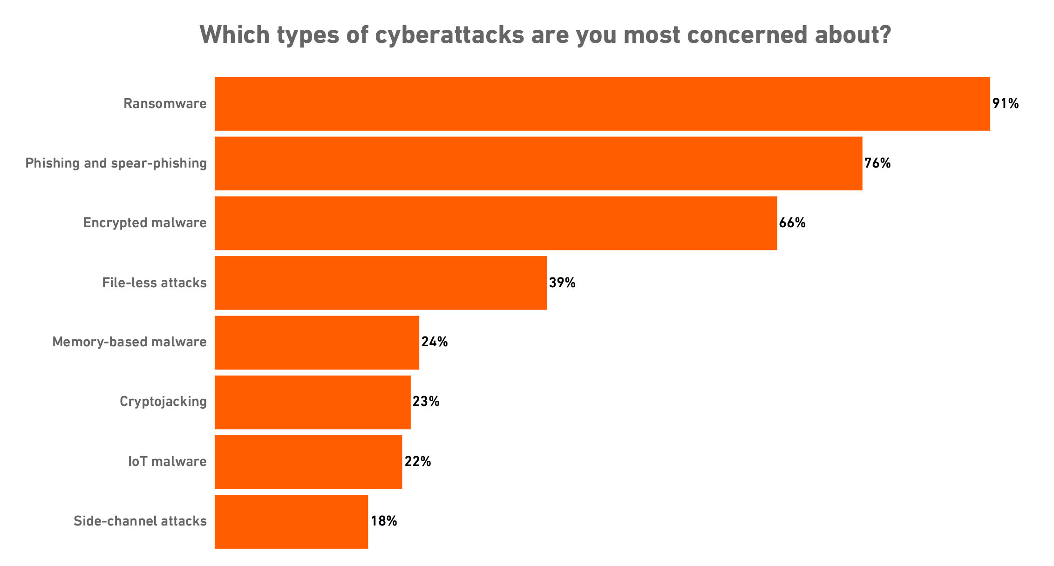
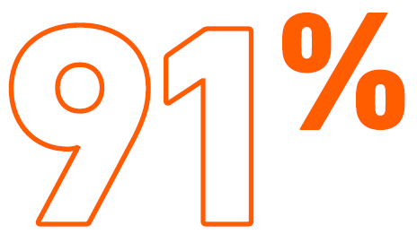
RANSOMWARE REMAINS TOP OF MIND
Despite a decline in overall volume in 2022, ransomware was chosen by 91% of respondents as their top concern in 2022.
Notes:
Source: 2022 SonicWall Threat Mindset Survey

Slide 12
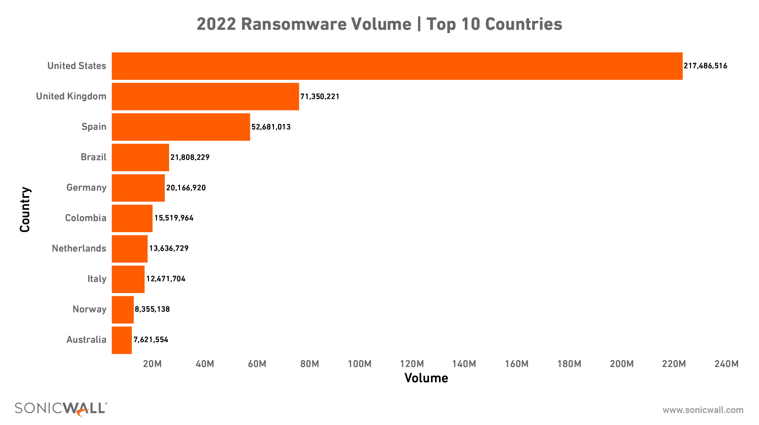
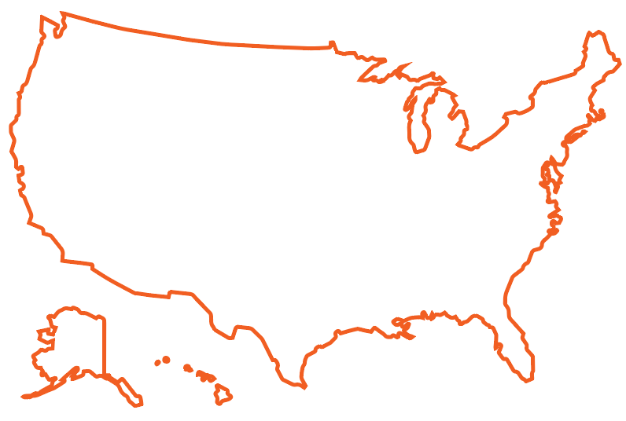
RANSOMWARE: TOP 10 COUNTRIES
Much like 2021, the United States was targeted by the most ransomware in 2022.
The United Kingdom and Spain rounded out the top three countries targeted by ransomware.

Slide 13
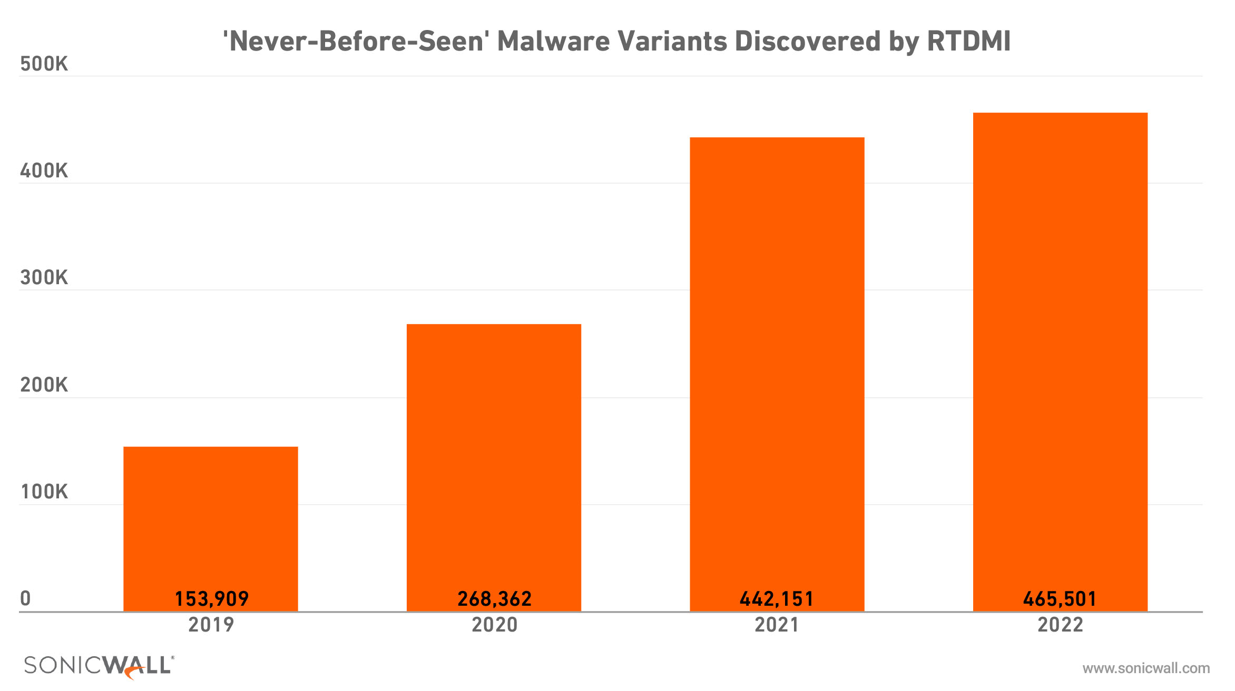
RTDMI DISCOVERIES CONTINUE TO GROW
SonicWall’s Real-Time Deep Memory Inspection™ (RTDMI) discovered 465,501 never-before-seen malware variants in 2022 — an average of 1,279 per day. Total RTDMI discovered also eclipsed 1 million in 2022.
Notes:
SonicWall Capture ATP and patented Real-Time Deep Memory Inspection™ (RTDMI) continued to raise the bar, with RTDMI discovering 465,501 never-before-seen malware variants last year — an average of 1,279 per day.
This increase was enough to push the all-time number of never-before-seen malware variants discovered past the 1 million mark. The 2022 count also represented the first time a yearly detection total surpassed 450,000.
In March alone, RTDMI detected 59,259 new variants, more than in any other month ever. Combined with higher-than-average discoveries in January and February, this helped push Q1 to a total of 147,851 never-before-seen malware variants — the highest of any quarter on record.

Slide 14
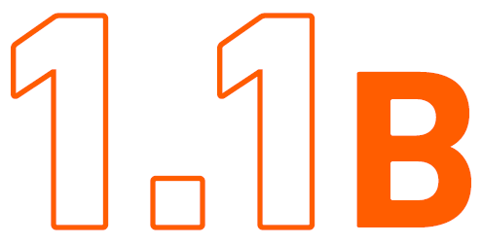
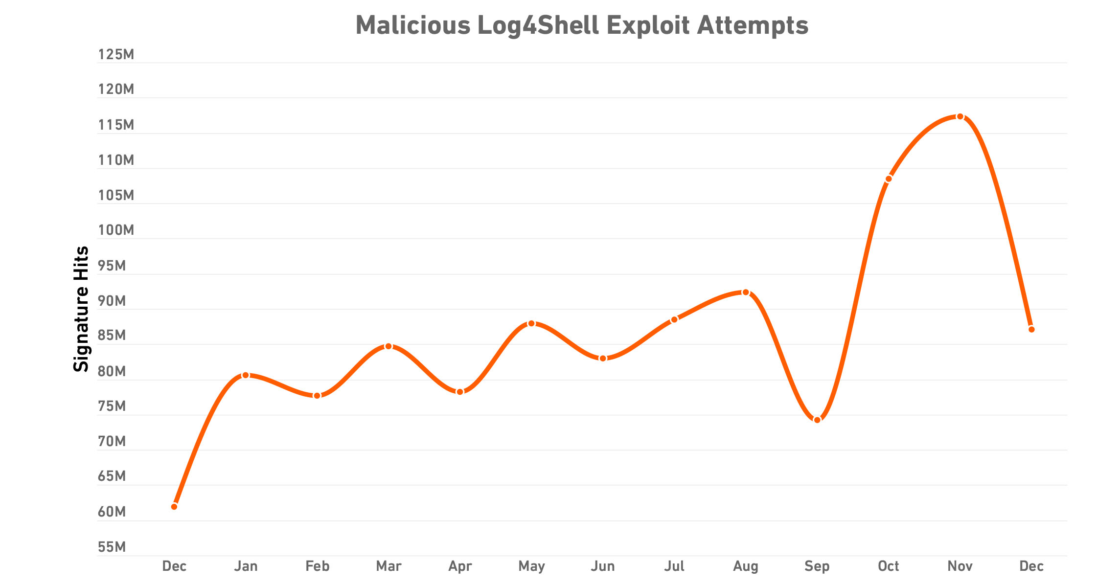
‘LOG4SHELL’ EXPLOITS ECLIPSE 1 BILLION
While the Apache Log4j vulnerability known as ‘Log4Shell’ was the final major vulnerability identified in 2021, it quicky became one of the most exploited throughout 2022.
SonicWall recorded 1.1 billion exploit attempts against Log4Shell — an average of 3.1 million each day.
Notes:
Since December 2021, SonicWall Capture Labs threat researchers have been tracking attempted exploits of this vulnerability, and so far, attack volumes show no signs of slowing.
While some had hoped for an initial frenzy of attacks followed by a gradual decrease, our researchers have observed the opposite: 61.9 million attempts were observed in December 2021, the month the attacks were announced — and every month in 2022 exceeded that total by at least 10 million. Worse, these attempts seemed to pick up steam as 2022 went on: The second half of the year had 15% more intrusion attempts than the first half.

Slide 15
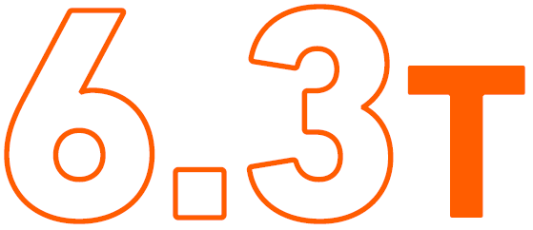
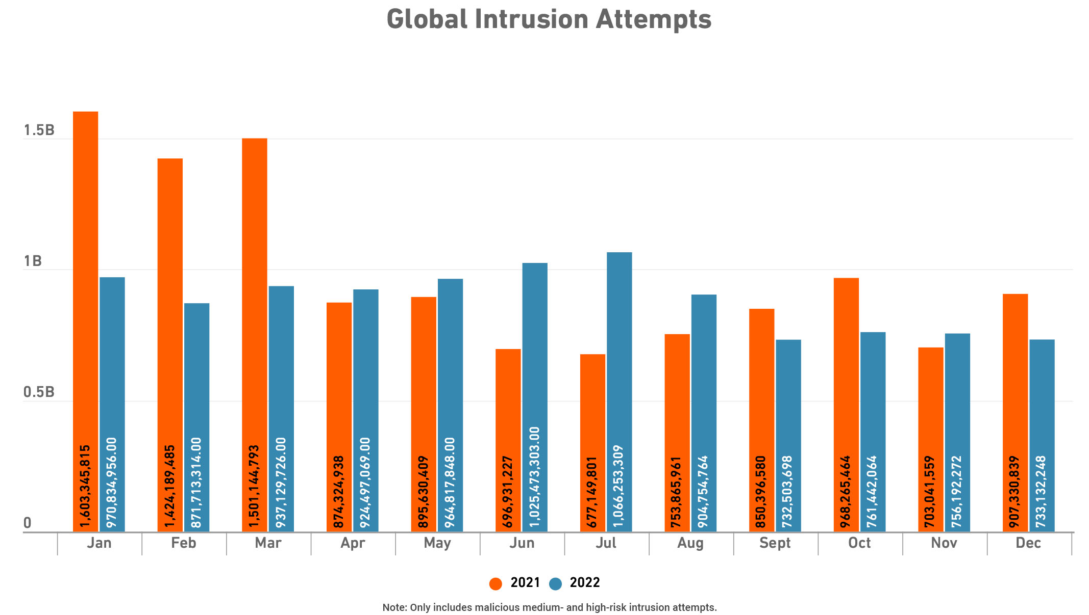
OVERALL INTRUSION ATTEMPTS UP
Intrusion attempts hit a new high of 6.3 trillion in 2022, a 19% year-over-year increase.
However, the number of moderate- or high-severity intrusion attempts, also known as malicious intrusion attempts, fell in 2022, dipping to 10.6 billion — a 10% year-over-year drop.

Slide 16
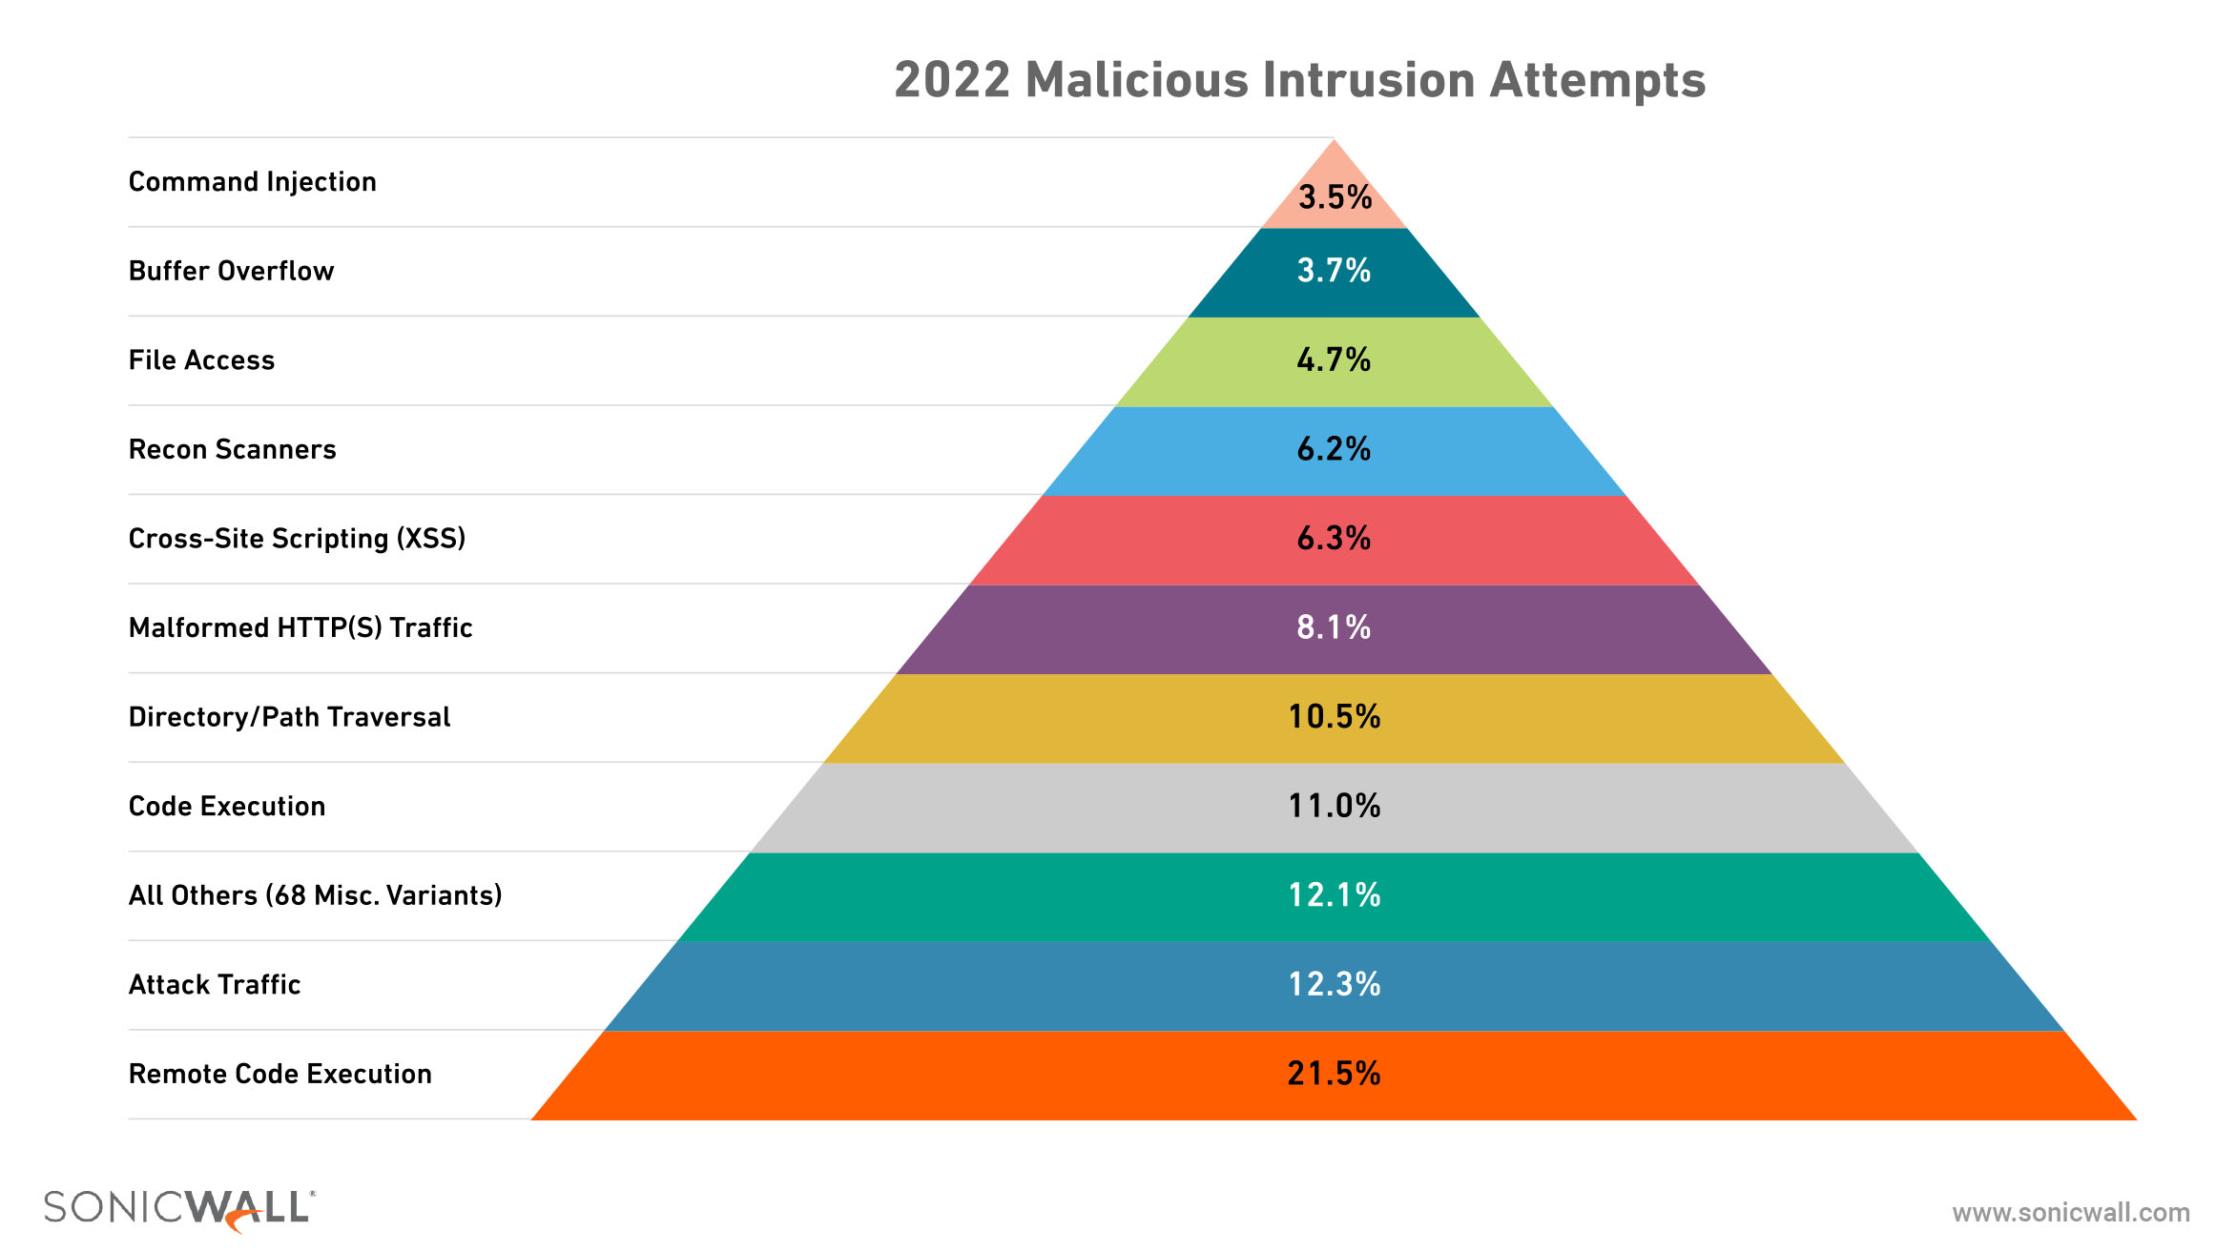
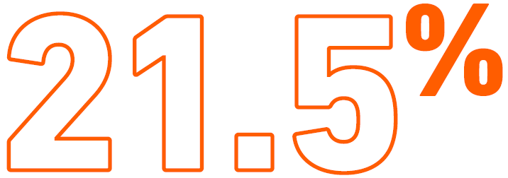
RCEs TOP INTRUSION TYPE
Remote Code Executions (RCEs) are once again the most common form of malicious intrusion we observed. RCEs made up 21.5% of all malicious intrusions in 2022.
Notes:
While very little in the cybersecurity world has returned to its 2019 state, malicious intrusion types are one exception: Just like we saw four years ago, Remote Code Executions (RCEs) are once again the most common form of malicious intrusion we observed.
What is an RCE?
An RCE attack takes place when a threat actor uses a vulnerability to remotely run malicious programming code, usually in an unexpected path and with system-level privileges. (The infamous Bluekeep vulnerability is one example of this.) These vulnerabilities are among the most dangerous on software systems and are frequently used to spread ransomware.

Slide 17
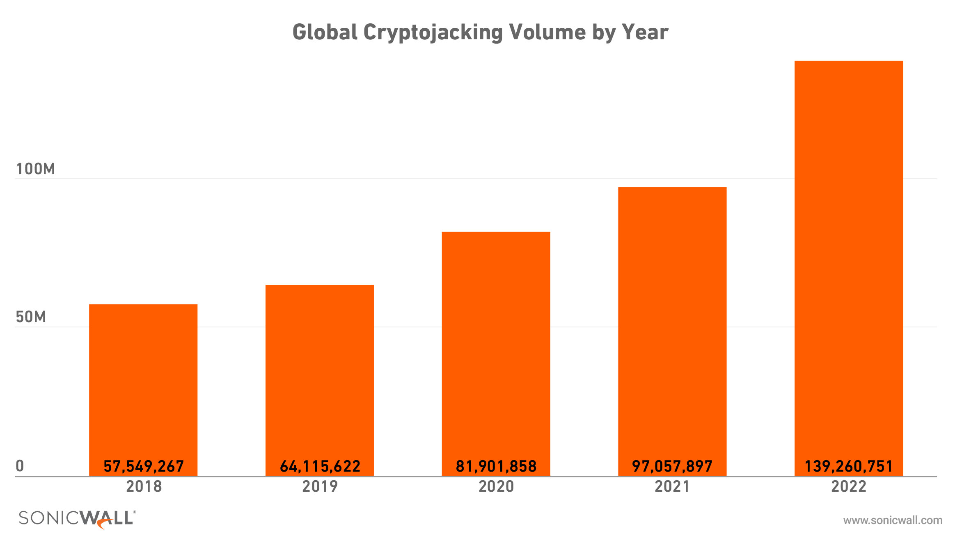
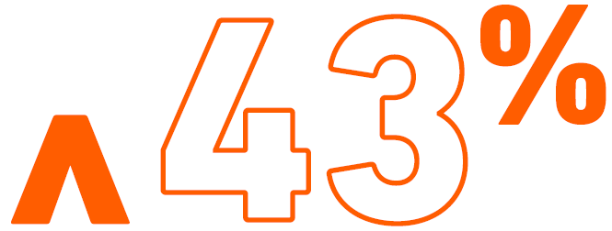
Cryptojacking ON RECORD-BREAKING RUN
In 2022, SonicWall researchers recorded a 43% increase in cryptojacking. This growth set a new record and pushed observed attack volumes past the 100-million mark for the first time ever.
Notes:
Threat actors augmented ransomware with more steady and low-profile revenue streams in 2022, pushing cryptojacking past the 100 million mark for a new record high. SonicWall recorded 139.3 million cryptojacking attacks in 2022, representing a 43% increase over 2021 and a 142.3% increase since SonicWall began tracking this malware in 2018. With several new campaigns surfacing late in the year, we’re likely to see this total continue to rise — particularly in Europe, where attack volume surged a staggering 549% year-over-year.

Slide 18
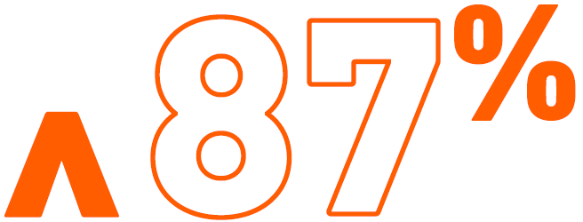
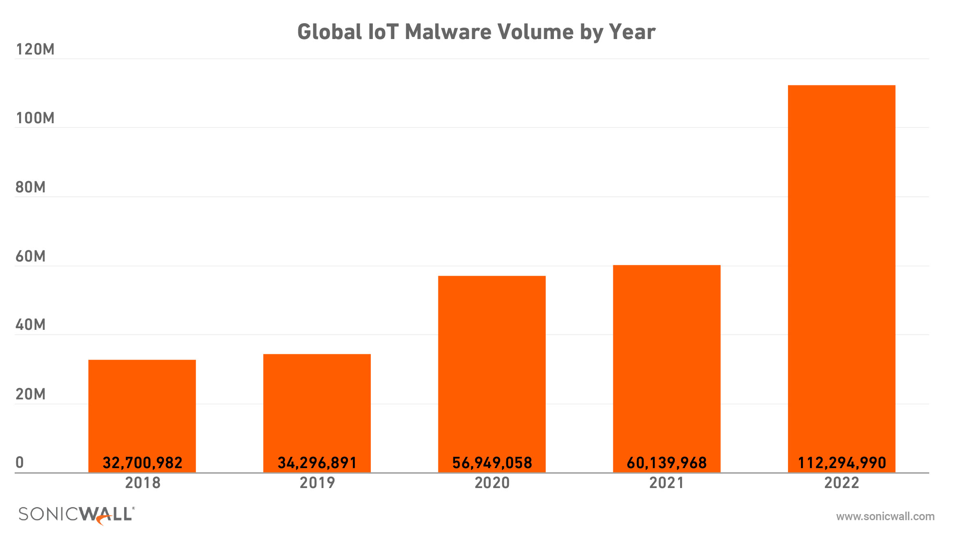
IoT MALWARE NEARLY DOUBLES
IoT malware volume jumped dramatically in 2022, breaking the 100 million mark for the first time and setting a new yearly record.
SonicWall Capture Labs threat researchers recorded 112.3 million attacks in 2022, an 87% year-over-year increase.
Notes:
When IoT malware attack volume rose just 6% in 2021 — after jumping 218% in 2019 and another 66% in 2020 — it offered hope that wild acceleration might be giving way to slower and more stable growth. In 2022, SonicWall Capture Labs threat researchers recorded 112.3 million instances of IoT malware, an 87% increase over 2021. Much of this spike was centered in North America, where attacks rose 145%, and the U.S., which saw volumes rise 169%.
This spike easily exceeded the previous record for IoT malware attacks observed by SonicWall in a single year, and it also pushed the number of attacks past the 100 million mark for the first time.

Slide 19
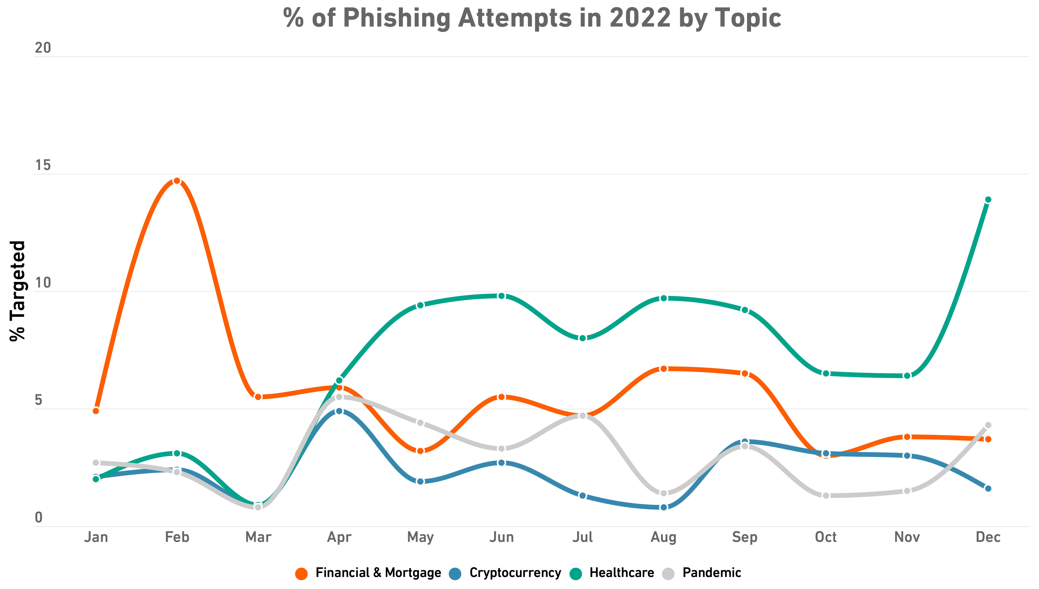
Top PHISHING TOPICS in 2022
Overall, phishing dipped 17% globally from the previous year.
As COVID-19 continued to shift from pandemic to endemic, SonicWall observed a drop in pandemic-related phishing, and a corresponding rise in finance- and mortgage-based phishing.

Slide 20
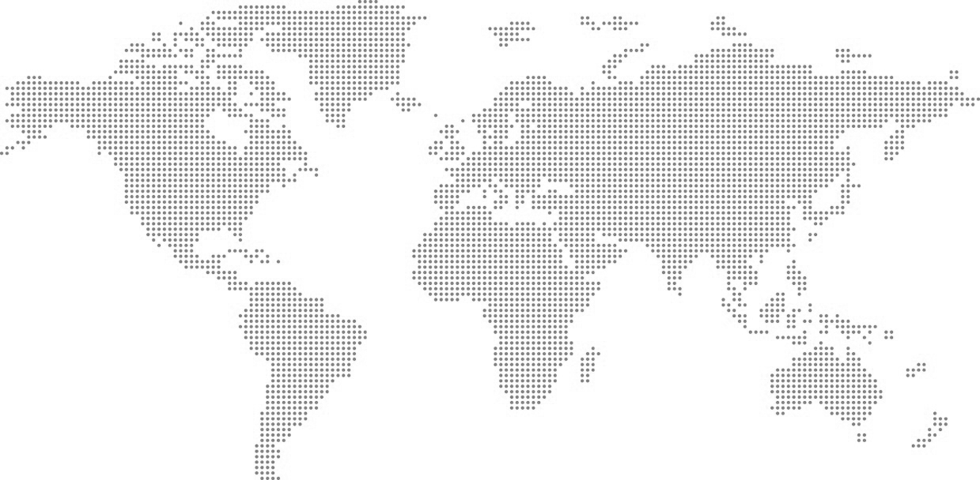
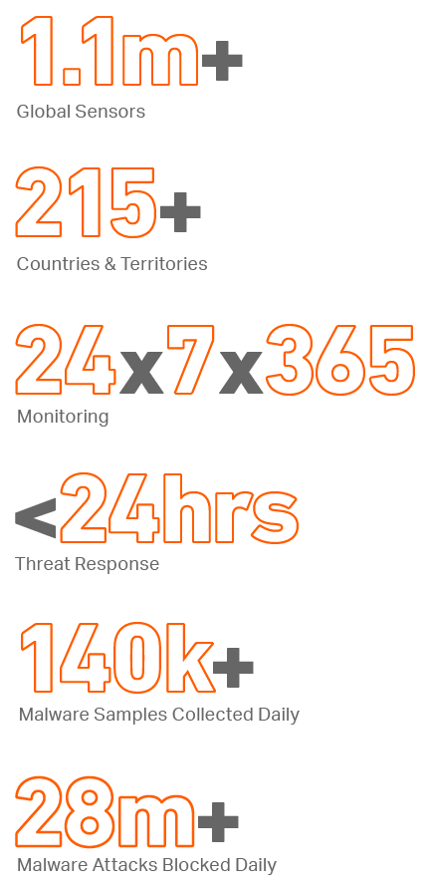
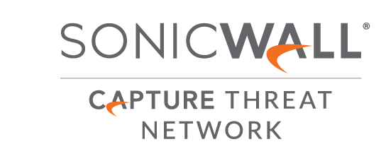
SONICWALL CAPTURE LABS THREAT NETWORK

Slide 21
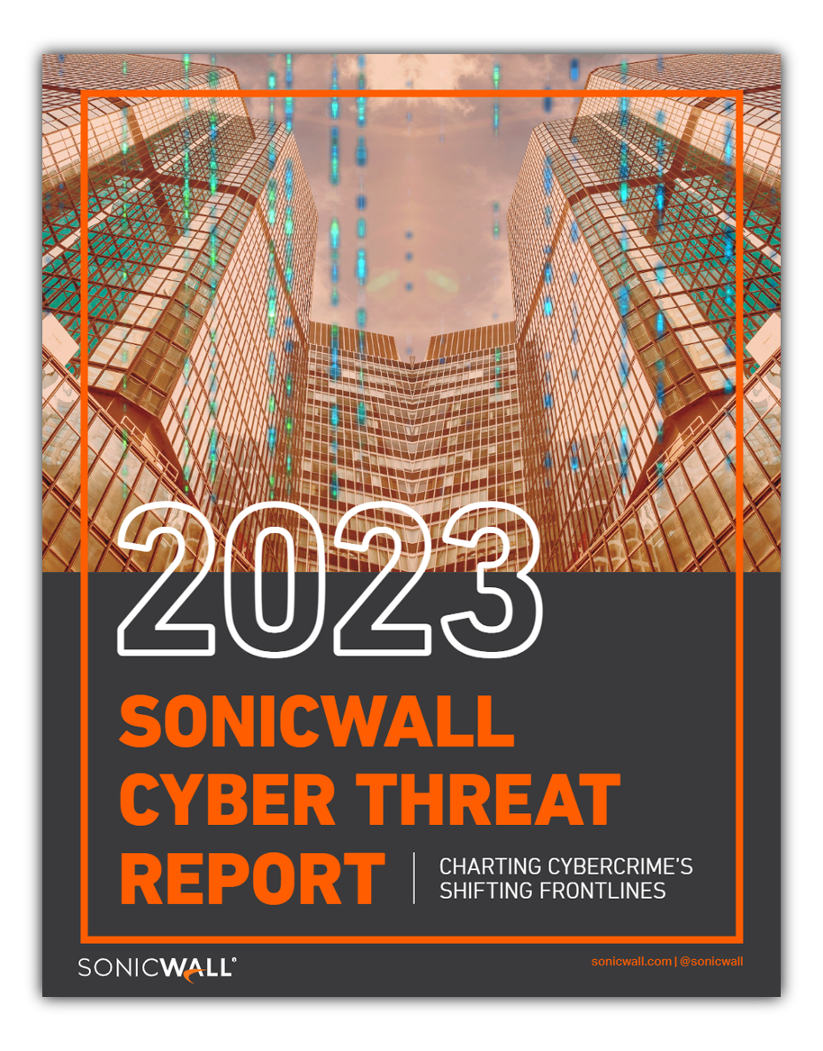
#KnowTheThreats
GET THE LATEST CYBER INTELLIGENCE
Download the 2023 SonicWall Cyber Threat Report to gain exclusive insight into cybercrime’s shifting frontlines and how changing behaviors may impact your organization.
DOWNLOAD THE REPORT
SonicWall.com/ThreatReport

Slide 23
REGIONAL
APPENDIX

Slide 24
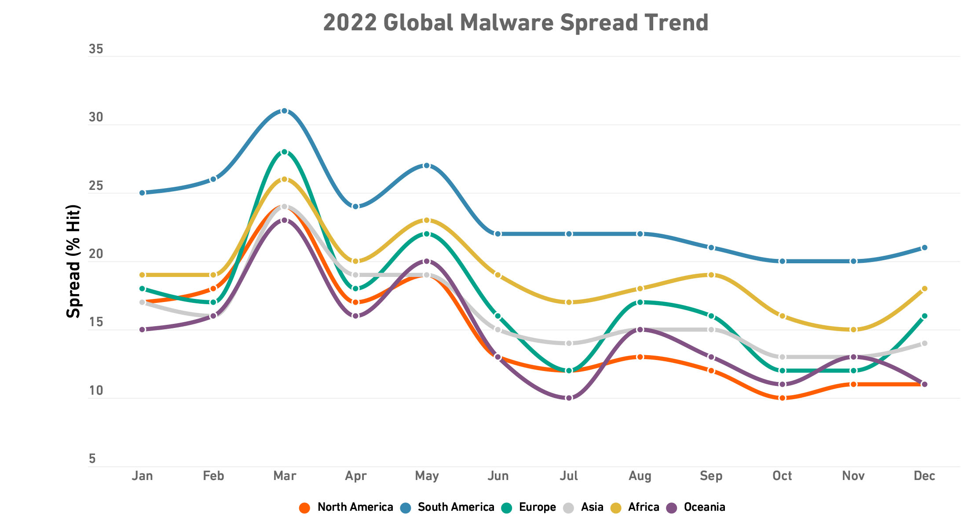
MALWARE: GLOBAL SPREAD
SonicWall tracks the overall spread of malware across global, regional and national footprints.

Slide 25
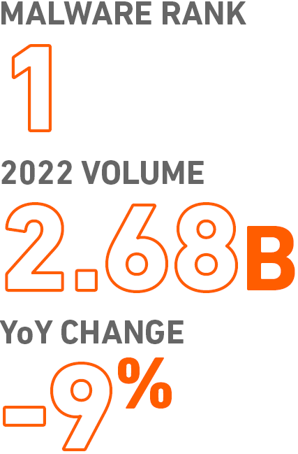
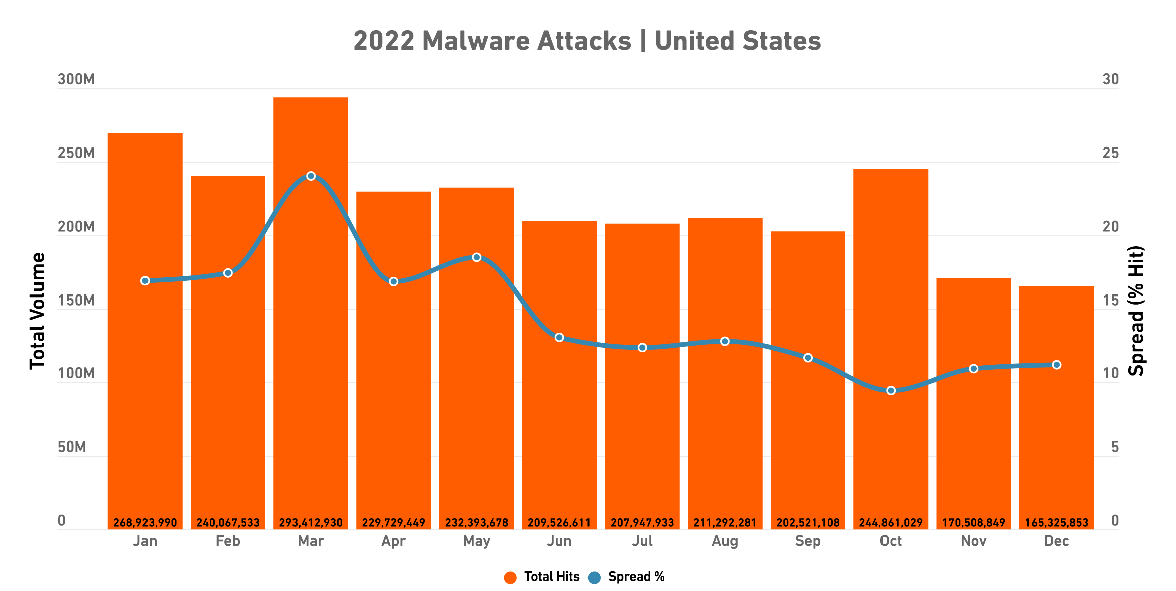
MALWARE: UNITED STATES
After averaging more than 250 million in the first quarter, malware in the U.S. trended downward as cybercriminals began targeting other areas.

Slide 26
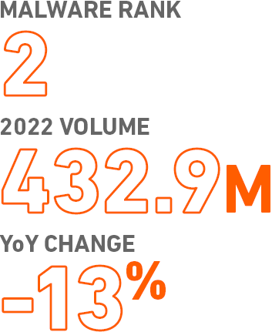
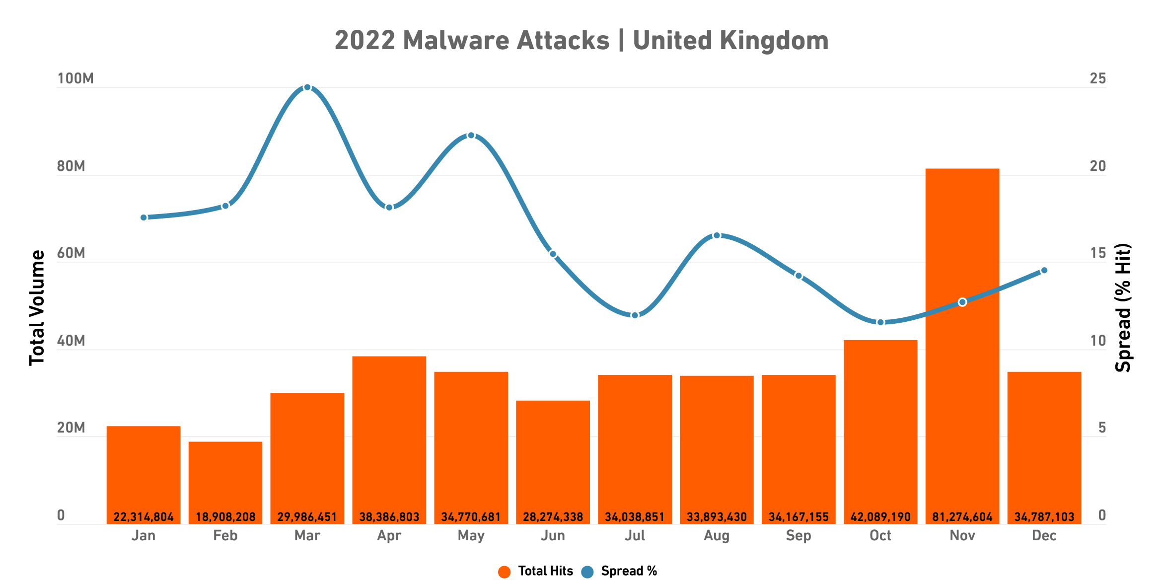
MALWARE: UNITED KINGDOM
Malware in U.K. trended upward as 2022 went on, with Q4’s totals up 122% from Q1’s. But low volume in the first half contributed to an overall year-over-year decrease.

Slide 27
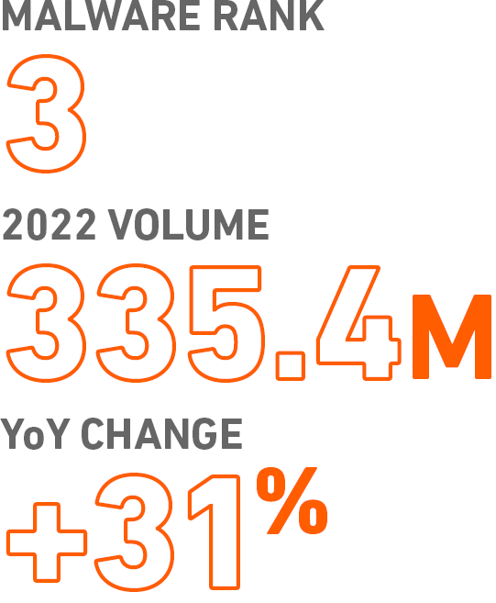
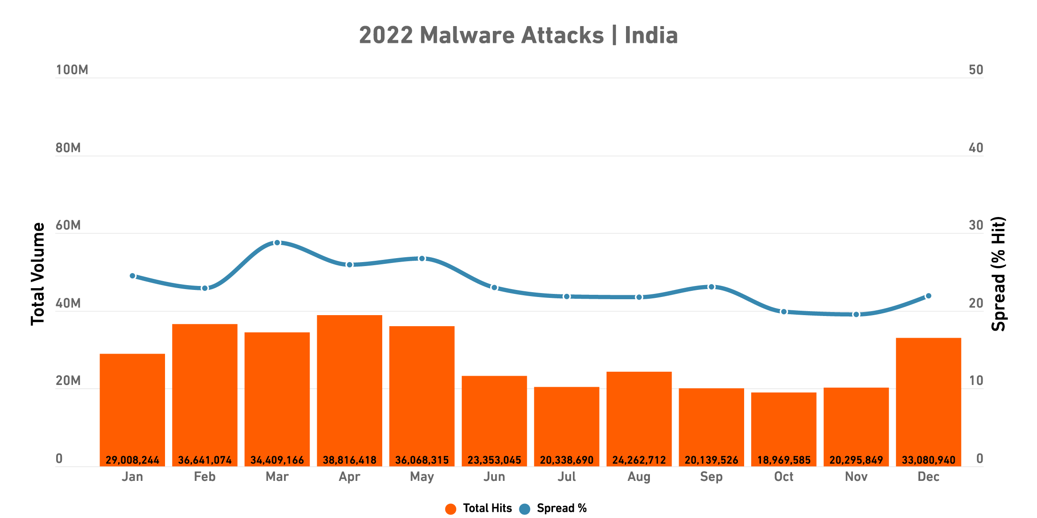
MALWARE: INDIA
Despite attack volumes mostly trending downward in 2022, India experienced the largest attack volume increase of any country we studied.

Slide 28
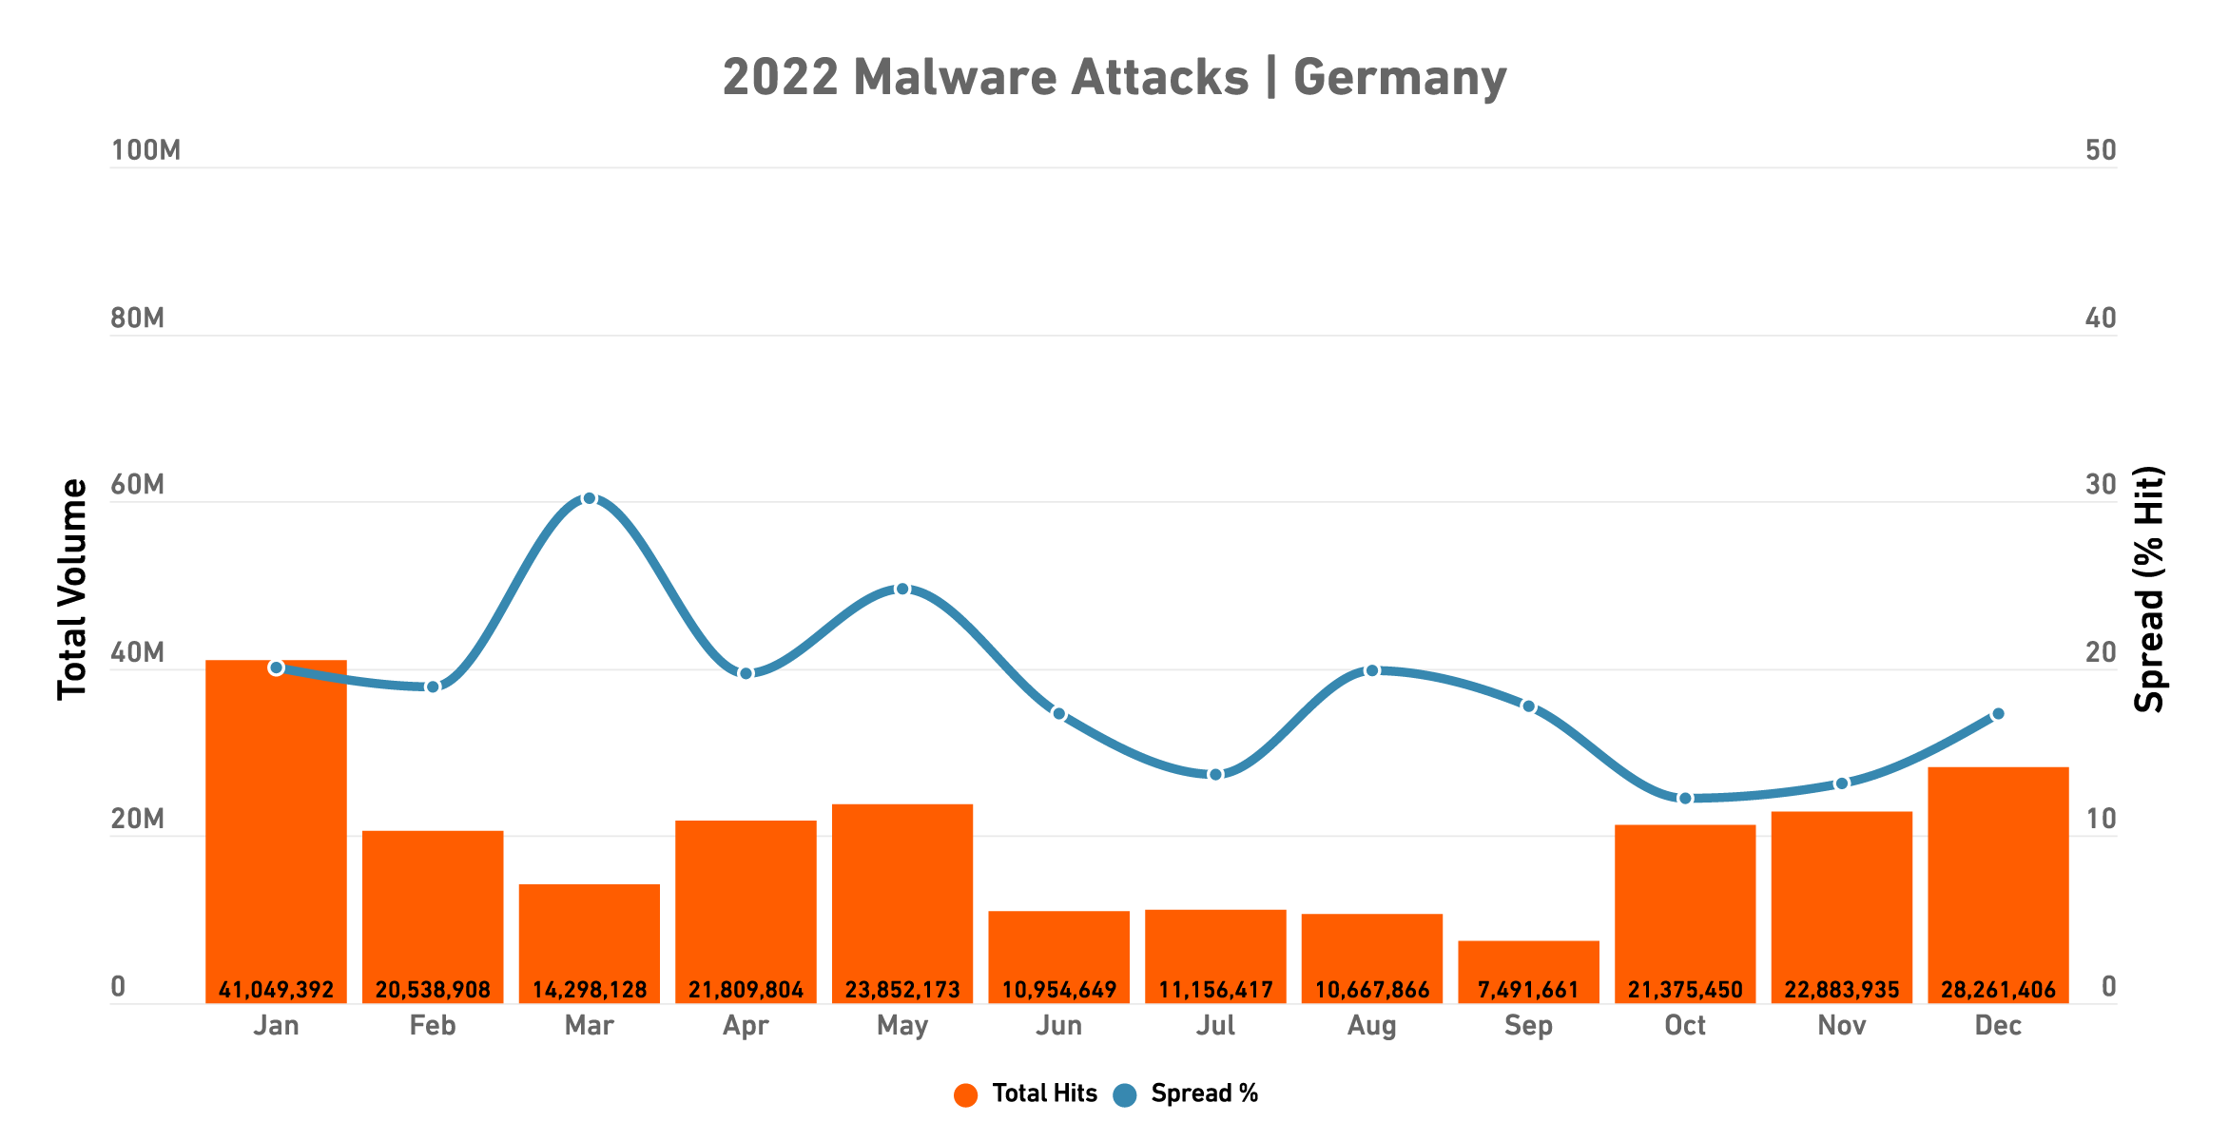
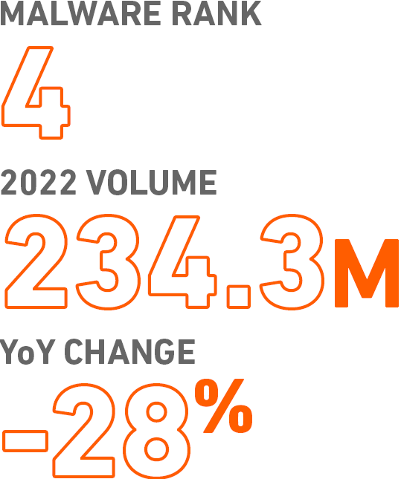
MALWARE: GERMANY
While attacks rebounded in Q4, it wasn’t enough to offset unusually low Q2 and Q3 volumes. The resulting 28% drop was the biggest decrease of any country we studied.

Slide 29
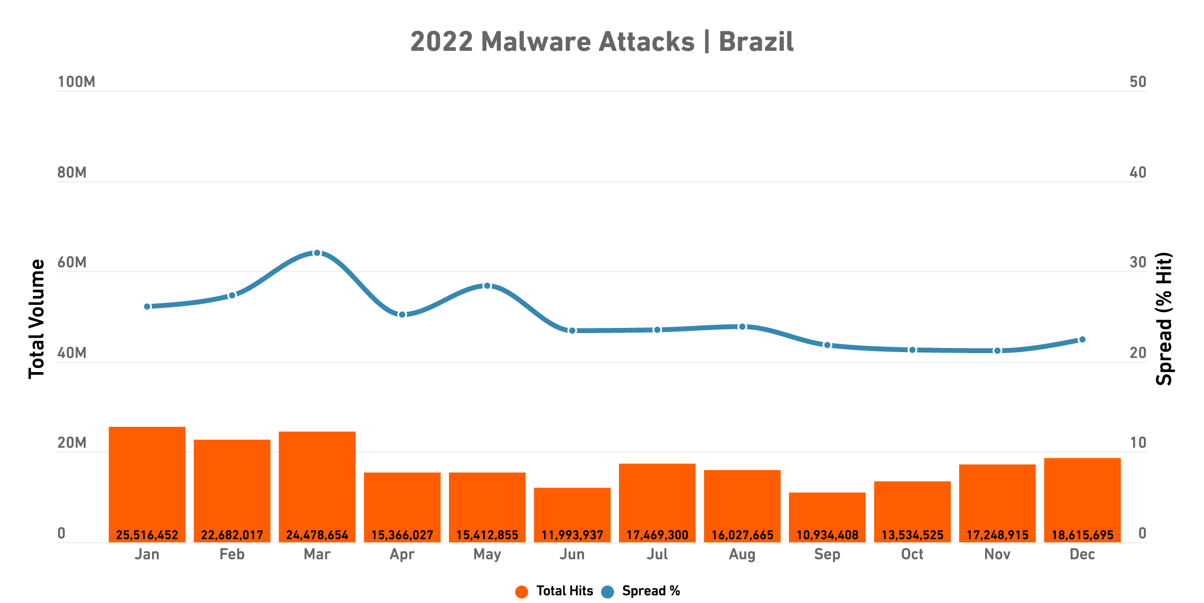
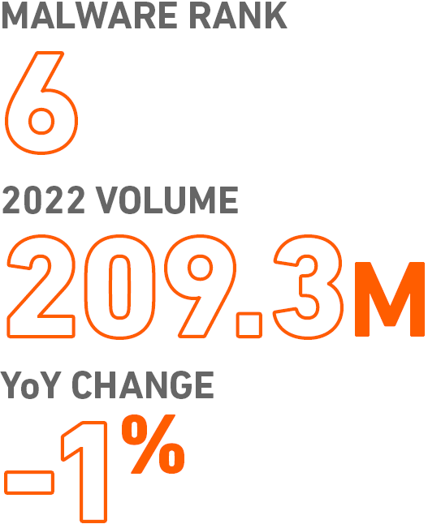
MALWARE: BRAZIL
With a difference of just 1.4 million between 2021’s malware total and 2022’s, yearly attack volume was essentially flat.

Slide 30
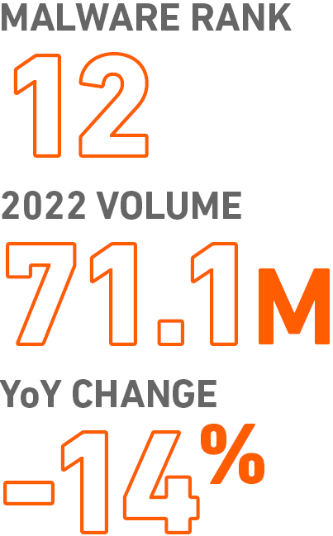
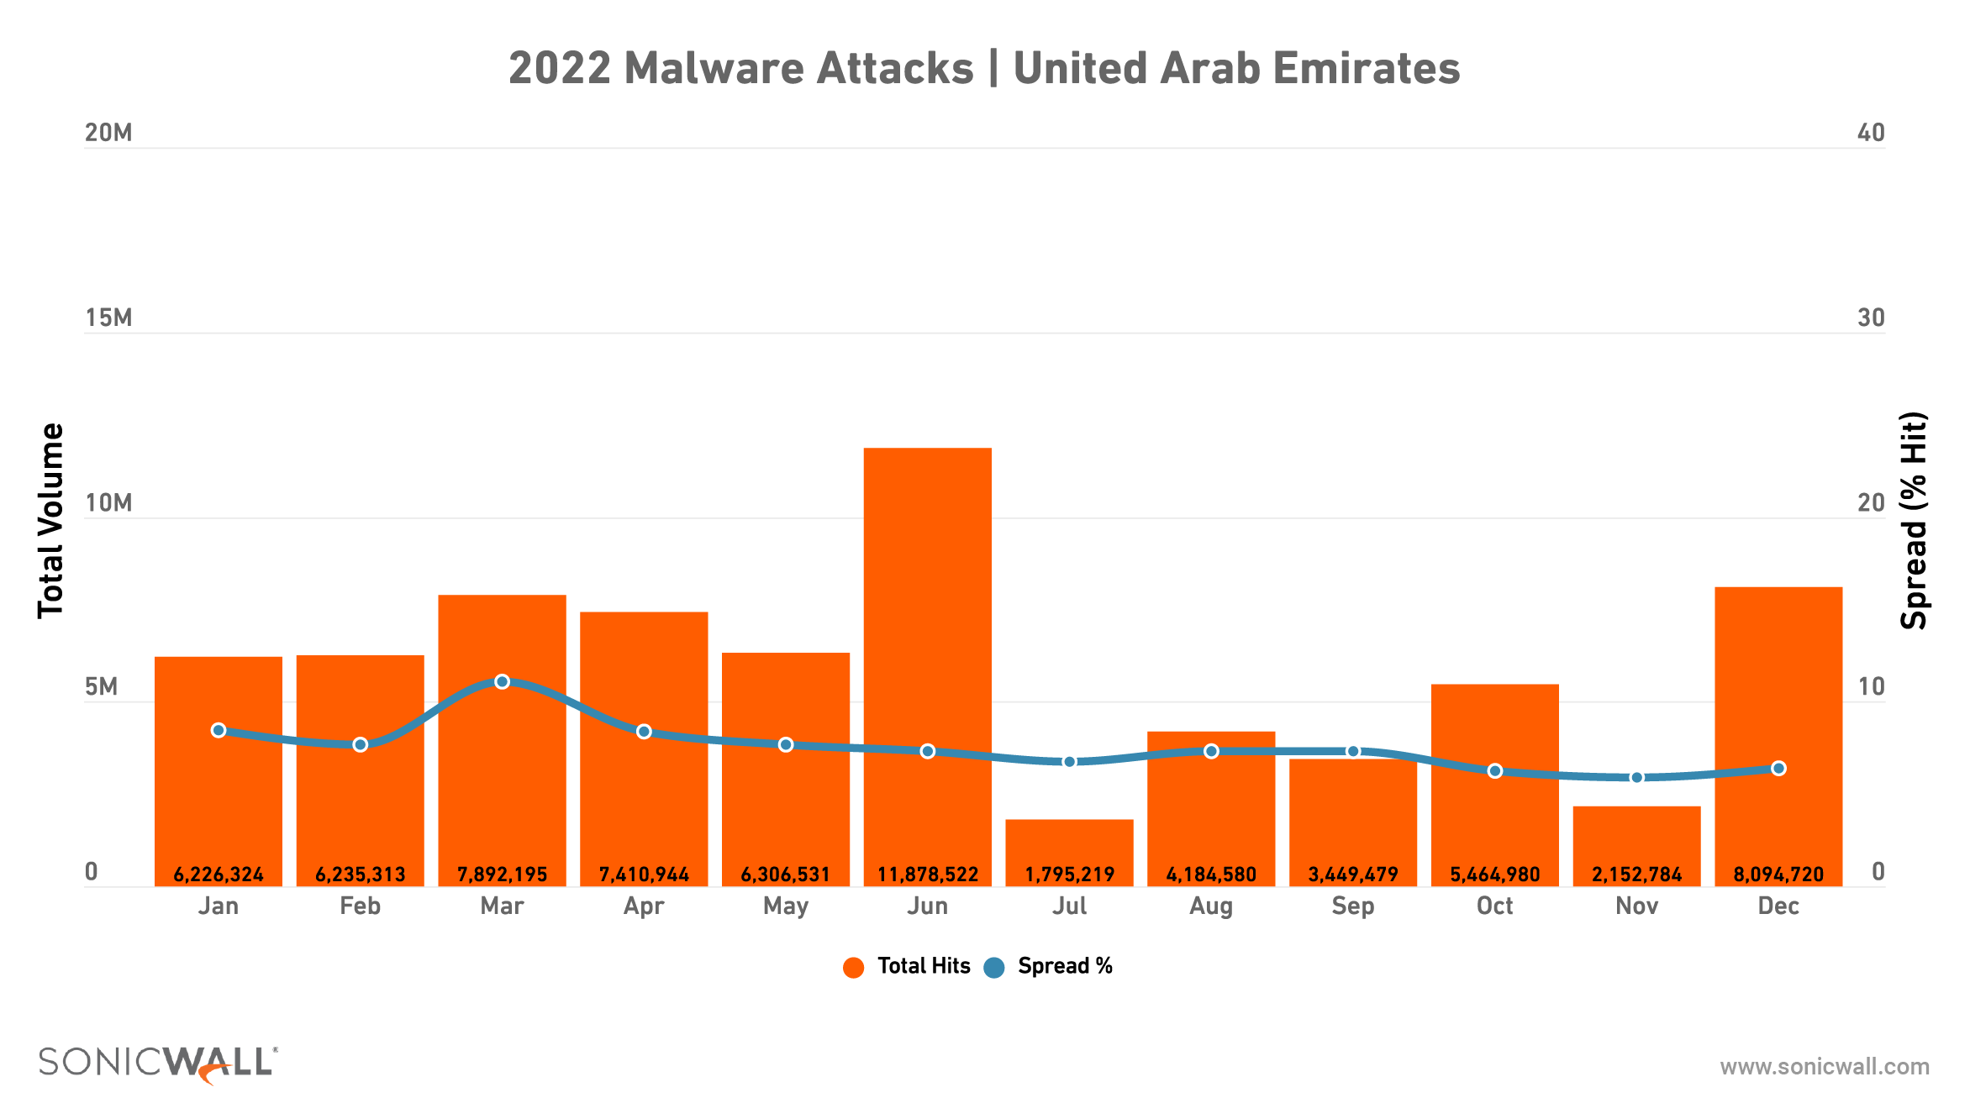
MALWARE: UNITED ARAB EMIRATES (UAE)
While malware in UAE dropped in 2022, this comes on the heels of a 33% increase in 2021 — meaning the region is still seeing dramatically higher malware.

Slide 31
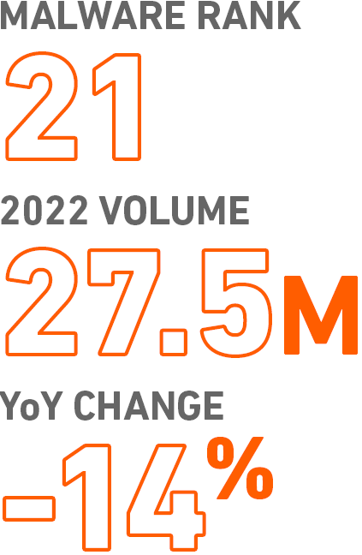
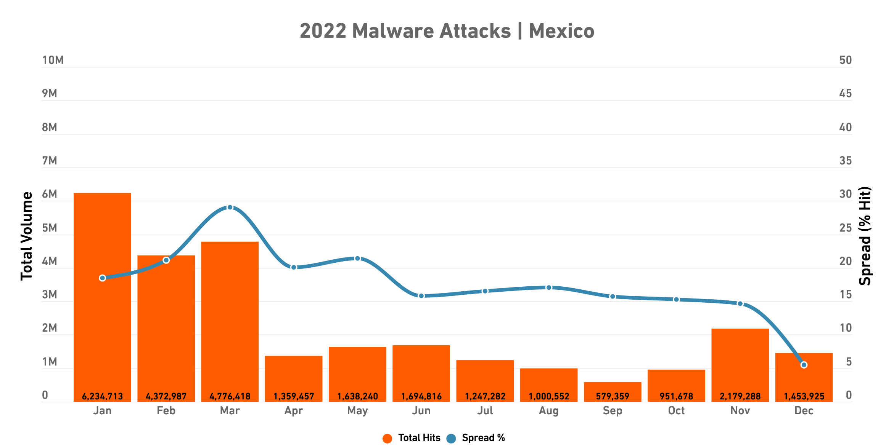
MALWARE: MEXICO
Malware in Mexico has recently reversed course: After increasing 73% in 2020, it increased just 3% in 2021, then dropped in 2022.

Slide 32
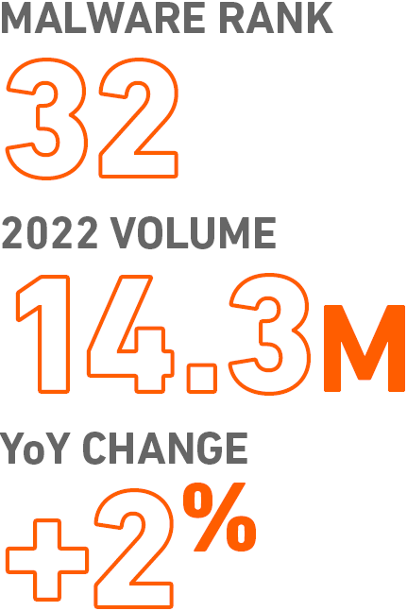
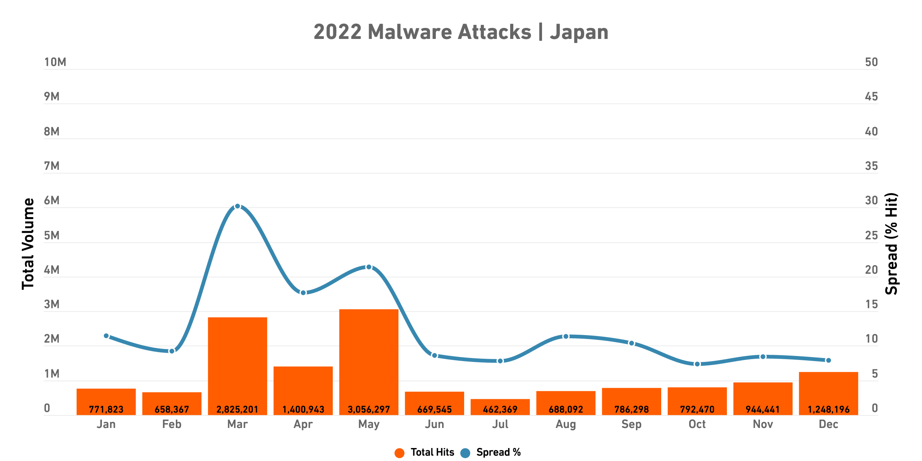
MALWARE: JAPAN
In March, malware spread in Japan spiked to just over 30% — though the yearly average was just under 13%.

